Slide 1

Solving Natural Language Processing Problems with Semantic Features
Dr. Terry Ruas – ruas@uni-goettingen.de - ruas@gipplab.org
2023-09-25

Slide 2
Outline
Introduction
University of Göttingen
Gipp Lab & Research
Research Projects (some)

Slide 3

Introductions

Slide 4








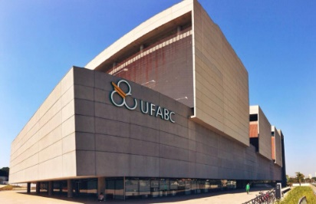
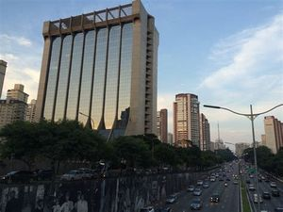
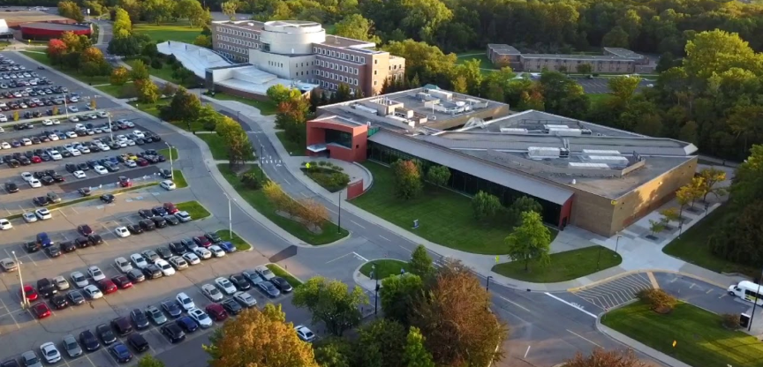

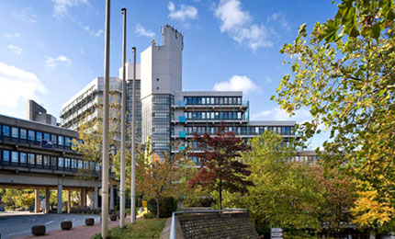
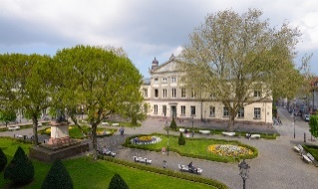
Terry Ruas
Federal University of ABC
CMCC – Centre of Mathematics, Computer Science and Cognition Bsc. (Jan. 2007 – Dec. 2010)
Msc. (Jan. 2012 – Dec. 2013)
IBM Brazil
Technical Software Solutions (Dec. 2009 – Jul. 2015)
University of Michigan Ph.D. Computer Science
(Sep. 2015 – Aug. 2019)
National Institute of Informatics
Ph.D. Internship
(Jan. 2018 – Jul. 2018)
University of Wuppertal
Postdoctoral Researcher
(Sep. 2019 – Jun 2022)
University of Göttingen
Postdoctoral Researcher
(from July 2022)

Slide 5
University of Göttingen

Slide 6
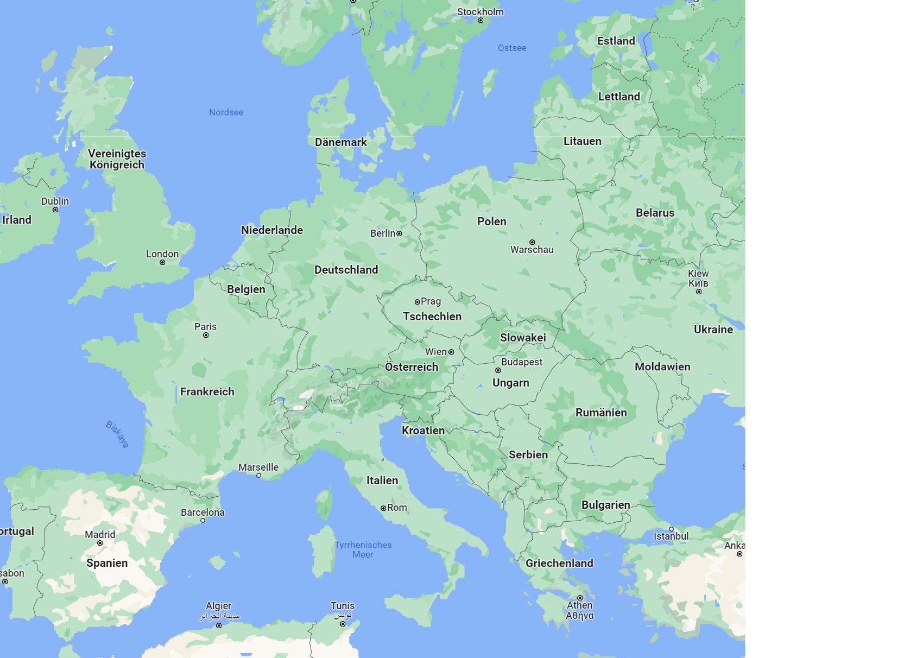
Göttingen

Slide 7
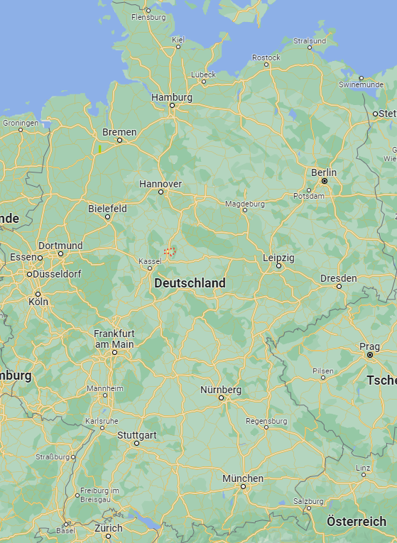
Göttingen

Slide 8
Göttingen

Slide 9
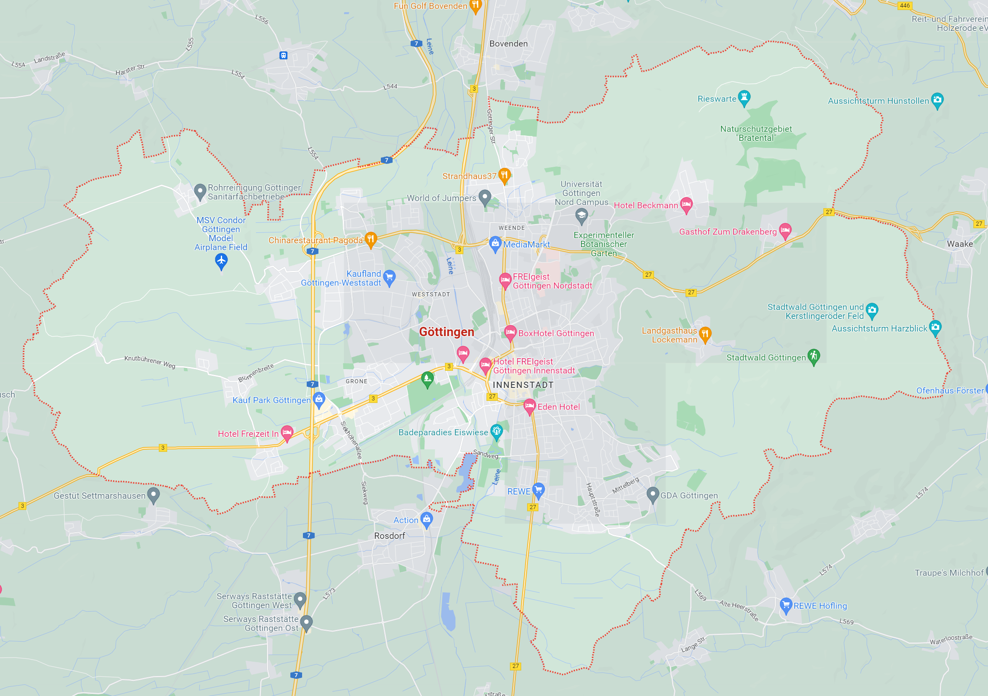
Göttingen

Slide 10
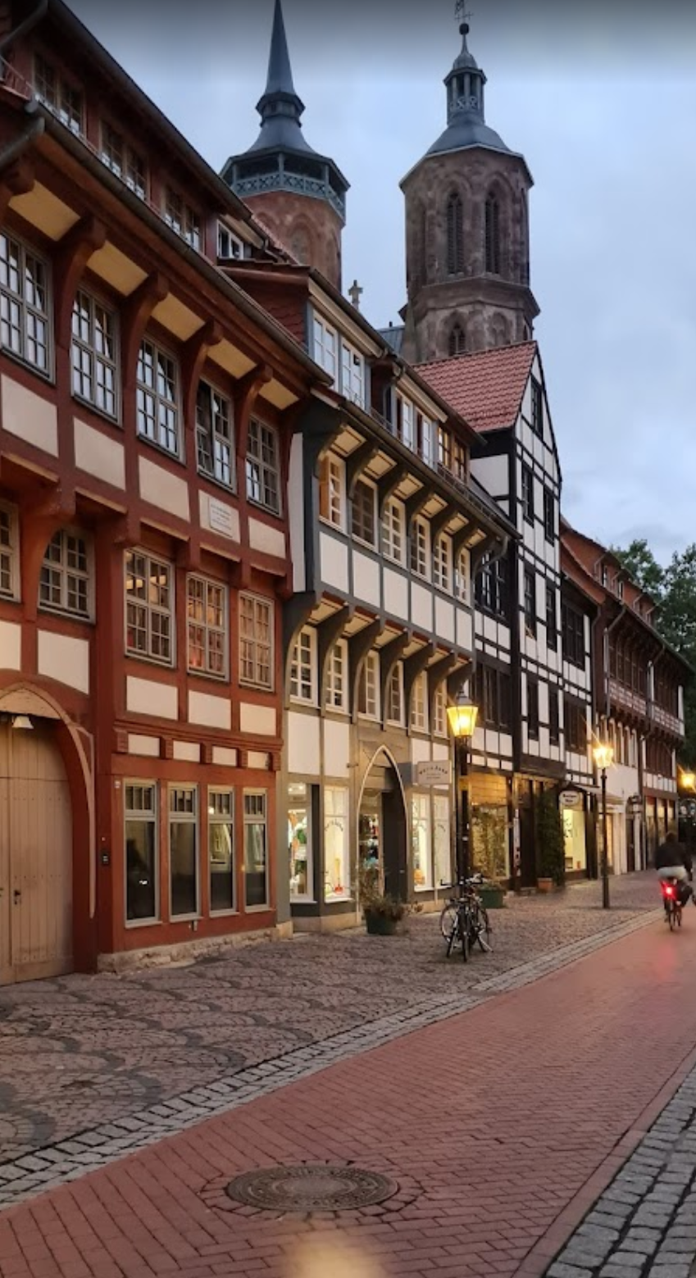
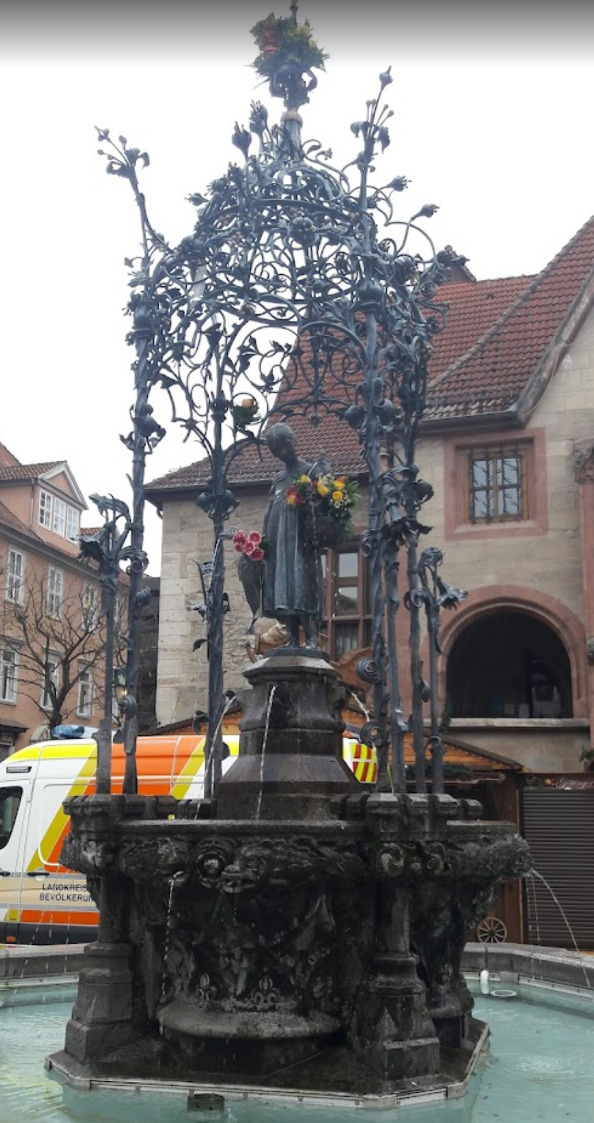
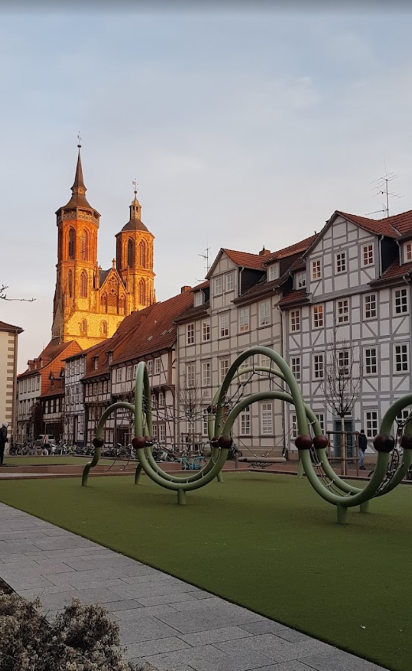

Göttingen
Göttingen, Niedersachsen (Lower Saxony)
Around 120K residents (ca. 30K are students)
Gänseliesel
Gauss-Weber Telegraph Memorial
Grave of Carl Friedrich Gauss
University of Göttingen (ca. 13K employees)
Max Planck Institute for Solar System Research Satellite Models
Easy train access to the entire Germany
More things to do/check here and here.

Slide 11
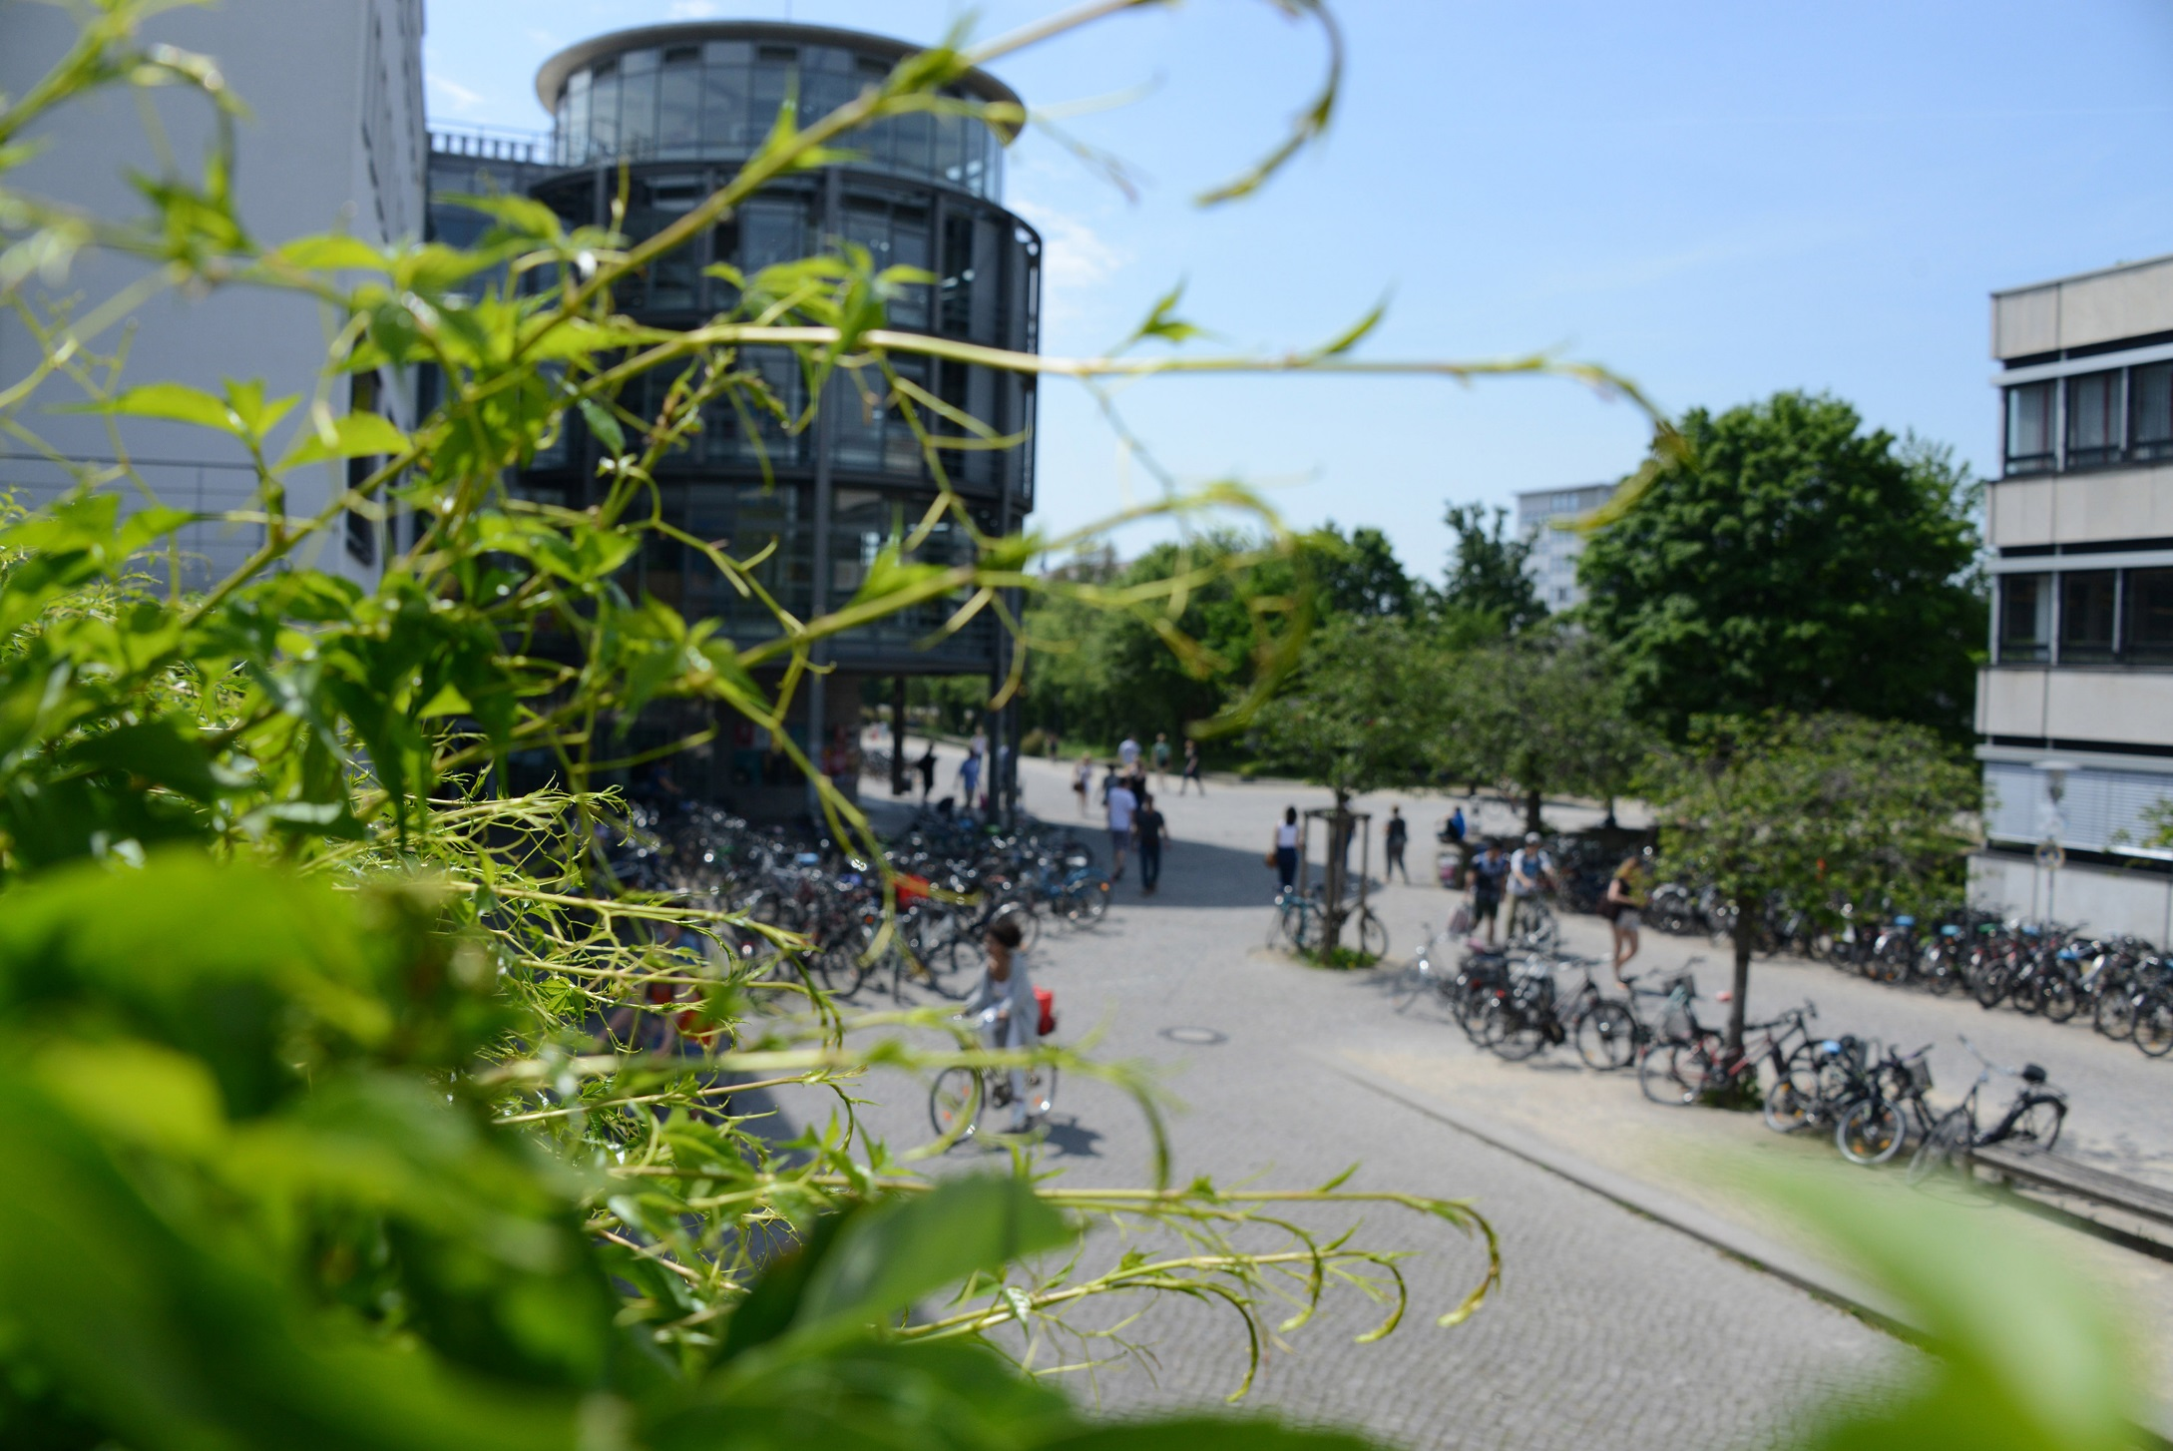
The University of Göttingen
An Introduction

Slide 12
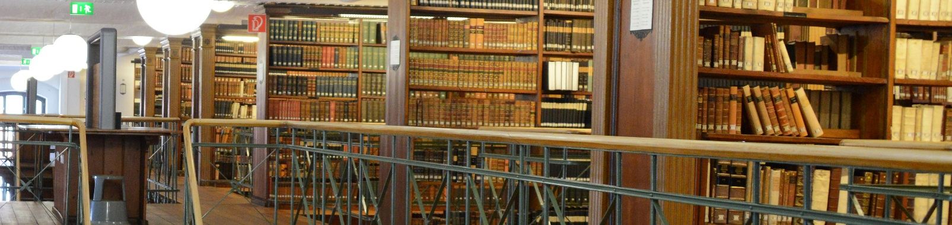
Profile of the University of Göttingen
Founded in 1737 as the University of Enlightenment
Research University of international importance
Focus on research-based teaching
Around 30,000 students, of which 14% are international (230 different degree programs)
13,300 employees (incl. the University Medical Center)
Top universities in Germany (11th) (source)
“Nobel Prize Wonder” (ca. 47 were linked to Göttingen via their Curriculum Vitae)

Slide 13
Profile of the University of Göttingen
Founded in 1737 as the University of Enlightenment
Research University of international importance
Focus on research-based teaching
Around 30,000 students, of which 14% are international (230 different degree programs)
13,300 employees (incl. the University Medical Center)
Top universities in Germany (11th) and World (119th) (source)
“Nobel Prize Wonder” (ca. 47 were linked to Göttingen via their Curriculum Vitae)

Slide 14
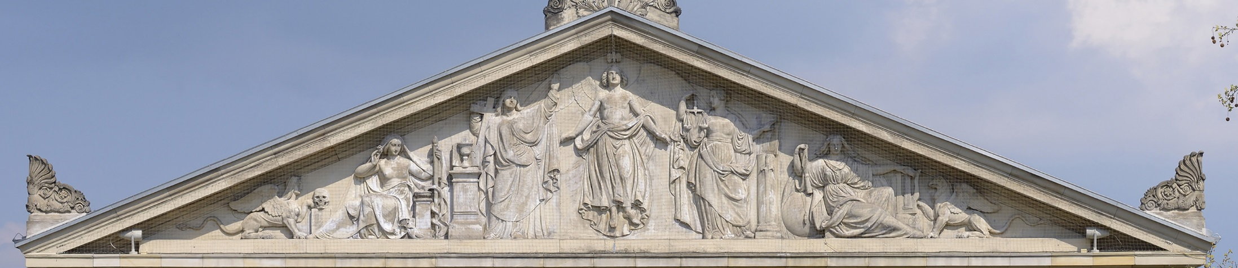
Foundation Under Public Law since 2003
Legal independence of the University from the state of Lower Saxony
Economic management and accounting conform to business principles
Employer with legal authority
University's properties constitute basic assets of the Foundation
High level of autonomy and leadership

Slide 15
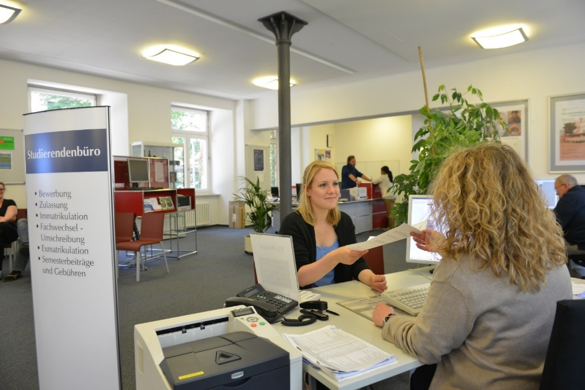
Largest Employer in the Region
13,300 employees at the University and the University Medical Center
4,000 employees in the scientific field
8,800 employees in the non-scientific field
50% female employees (and also students)
High internationalization level – 12% of the university’s employees are international
(Status 2021, all figures rounded)
Notes:
More than 30,000 students in the winter semester 2021/2022
4,000 students from abroad
230 different degree programs

Slide 16
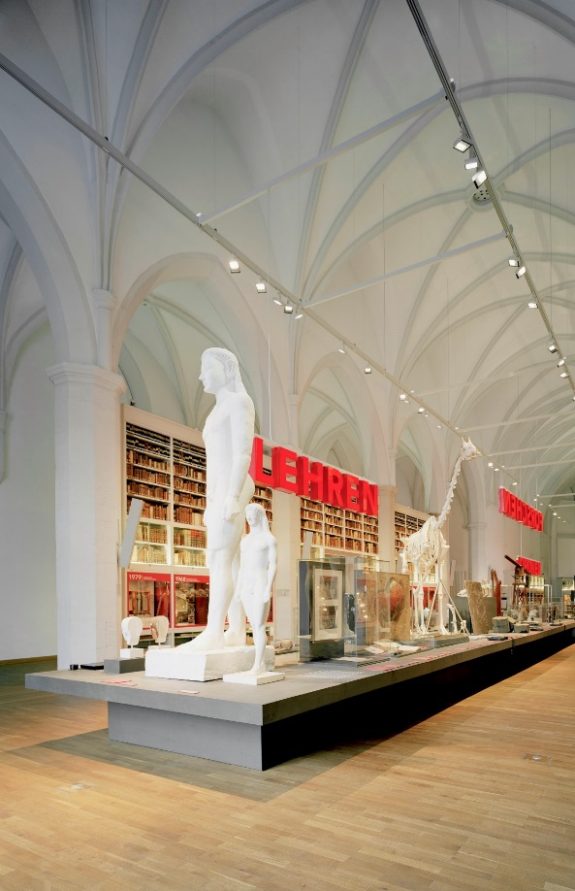
Faculties
The University of Göttingen comprises 13 faculties in:
Humanities and Theology
Chemistry, Physics, Biology and Psychology
Mathematics and Computer Science
Agriculture, Forestry and Geosciences
Law, Economics and Social Sciences
Medicine
Centers, institutes and affiliated institutes complete the profile
They offer unique opportunities for interdisciplinary cooperation

Slide 17

Campus Institute Data Science - CIDAS
CIDAS is a central scientific unit of the Georg-August-University.
The CIDAS is structurally divided into three levels
Social aspects of digitization/digitalization
Applied Data Science and Computer Science
Basics of Data Science
Promotes campus-wide interdisciplinary exchange and activities among faculties in the field of data science.
Research, teaching, and knowledge transfer.
Dedicated resources enable optimal basis for the development and implementation of collaborative projects in the field of data science
Financial means, spaces, equipment, IT infrastructure, and the use of computing and server capacities.
Notes:
Digitization refers to the process of converting physical information into digital formats, while digitalization refers to the use of digital technologies to improve business operations and create new value for customers.

Slide 18
Faculties - CS
The Computer Science Department is composed of the following research groups:
Data Fusion – Prof. Dr. Marcus Baum
Theoretical Computer Science – Prof. Dr. Carsten Damm
Neural Data Science – Prof. Dr. Alexander Ecker
Computer Networks – Prof. Dr. Xiaoming Fu
Scientific Information Analytics – Prof. Dr. Bela Gipp
Soft. Eng. for Distributed Systems – Prof. Dr. Jens Grabowski
Telematics - Prof. Dr. Dieter Hogrefe
High-Performance Storage - Prof. Dr. Julian Kunkel
Computer Graphics and Ecological Inf. - Prof. Dr. Winfried Kurth
Theoretical Computer Science - Prof. Dr. Florin Manea
Databases and Inf. Sys. - Prof. Dr. Wolfgang May
Didactics of Informatics - Hon.-Prof. Dr. Eckart Modrow
Computational Cell Analytics - Prof. Dr. Constantin Pape
Computer Security and Privacy - Prof. Dr. Delphine Reinhardt
Optimal transport - Prof. Dr. Bernhard Schmitzer
Machine Learning - Prof. Dr. Fabian Sinz
Digital Humanities - Prof. Dr. Caroline Sporleder
Didactics of Informatics - Prof. Dr. Kerstin Strecker
Data Science Infrastructures - Hon.-Prof. Dr. Philipp Wieder
Computational Neurosciences - Prof. Dr. Florentin Wörgötter
Practical Informatics – Prof. Dr. Ramin Yahyapour

Slide 19
Faculties and Research Groups - CS
The Computer Science Department is composed of the following research groups:
Data Fusion – Prof. Dr. Marcus Baum
Theoretical Computer Science – Prof. Dr. Carsten Damm
Neural Data Science – Prof. Dr. Alexander Ecker
Computer Networks – Prof. Dr. Xiaoming Fu
Scientific Information Analytics – Prof. Dr. Bela Gipp
Soft. Eng. for Distributed Systems – Prof. Dr. Jens Grabowski
Telematics - Prof. Dr. Dieter Hogrefe
High-Performance Storage - Prof. Dr. Julian Kunkel
Computer Graphics and Ecological Inf. - Prof. Dr. Winfried Kurth
Theoretical Computer Science - Prof. Dr. Florin Manea
Databases and Inf. Sys. - Prof. Dr. Wolfgang May
Didactics of Informatics - Hon.-Prof. Dr. Eckart Modrow
Computational Cell Analytics - Prof. Dr. Constantin Pape
Computer Security and Privacy - Prof. Dr. Delphine Reinhardt
Optimal transport - Prof. Dr. Bernhard Schmitzer
Machine Learning - Prof. Dr. Fabian Sinz
Digital Humanities - Prof. Dr. Caroline Sporleder
Didactics of Informatics - Prof. Dr. Kerstin Strecker
Data Science Infrastructures - Hon.-Prof. Dr. Philipp Wieder
Computational Neurosciences - Prof. Dr. Florentin Wörgötter
Practical Informatics – Prof. Dr. Ramin Yahyapour
For more.

Slide 20
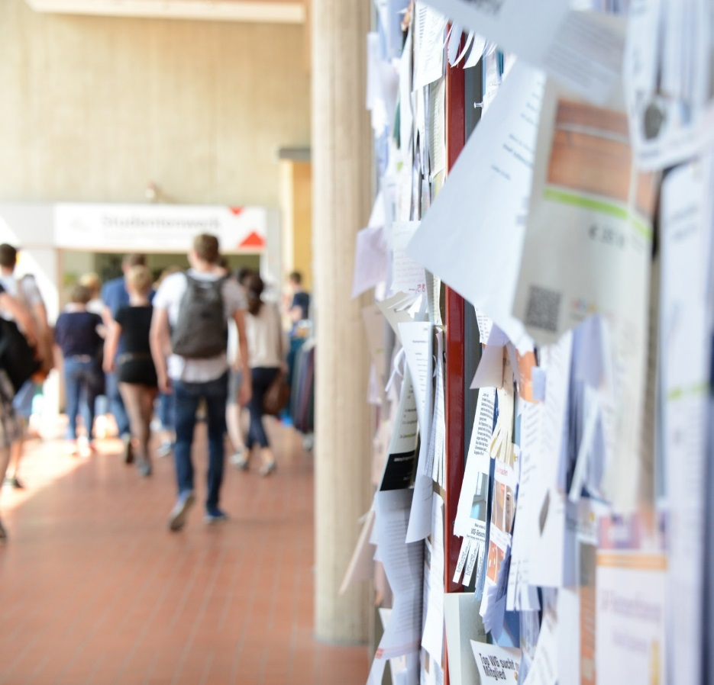
Popular Among Students
More than 30,000 students in the winter semester 2021/2022
4,000 students from abroad
230 different degree programs
Diversity of subjects and possible combinations in study programs

Slide 21
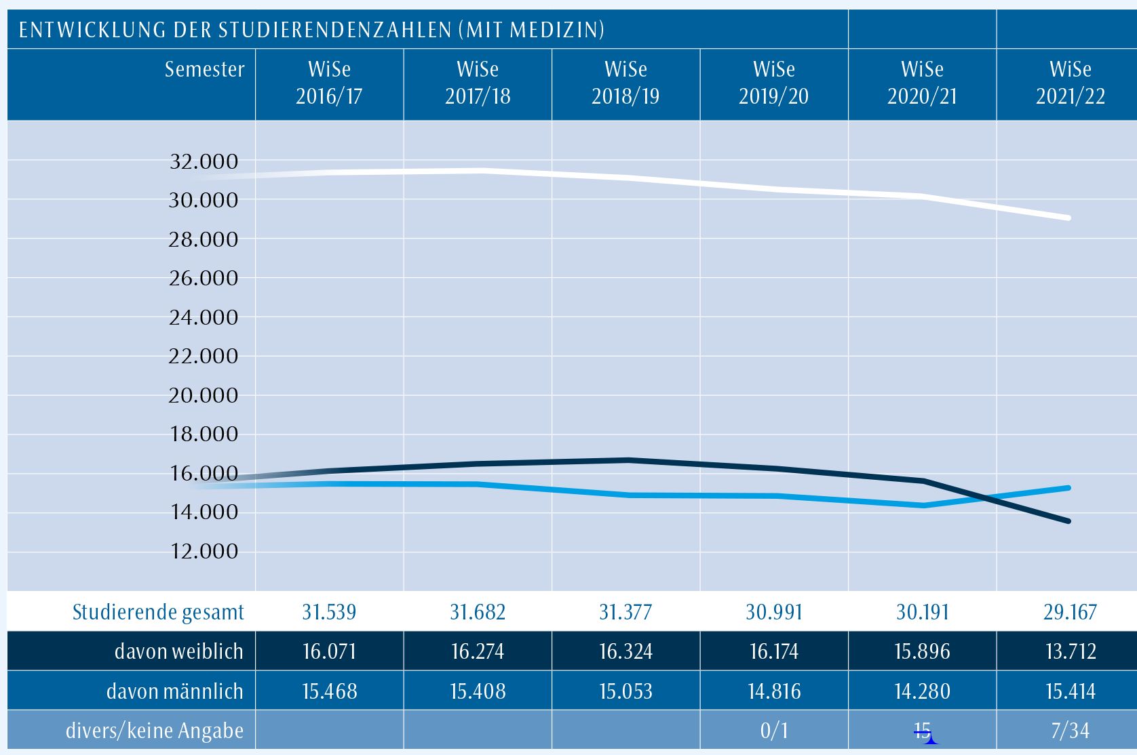
Evolution of Student Numbers

Slide 22
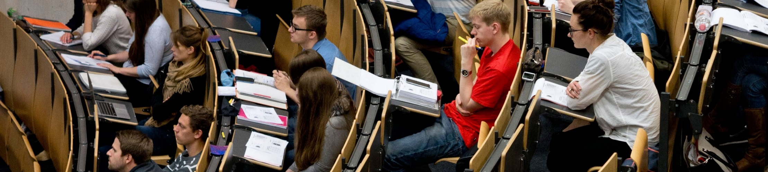
Our Quality Standards in Teaching
Research-oriented teaching
Disciplinary and interdisciplinary study programmes
International curriculum
Diversity and equal opportunities
High quality of advice and support
Innovative teaching and exam forms

Slide 23
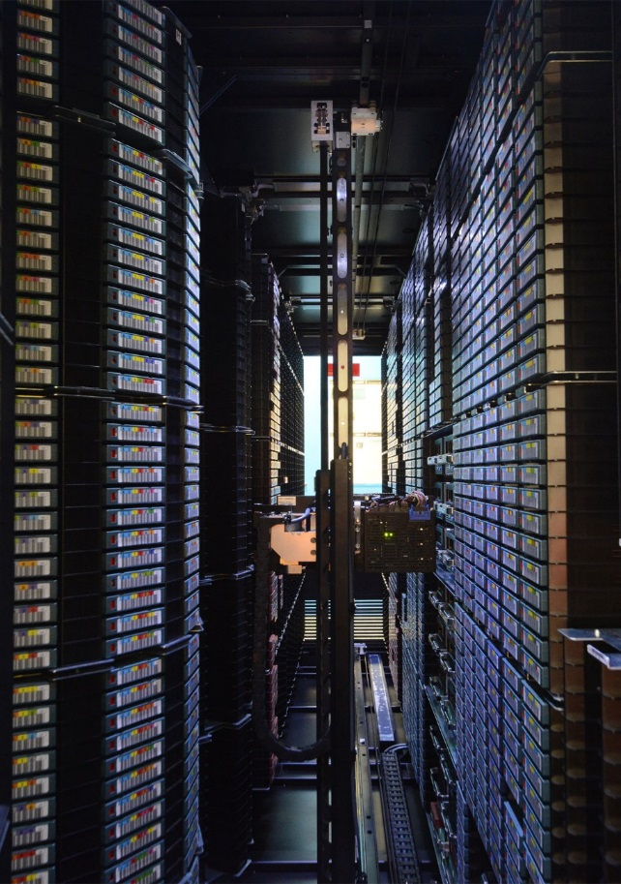
Infrastructure
Digital transformation and increasingly interconnected science place high demands on the management of complex and heterogeneous data.
Central partners of the University of Göttingen in the field of Development and Operation of Information and IT Infrastructure are
Lower Saxony State and University Library (SUB)
Society for Scientific Data Processing GmbH Göttingen (GWDG)
Research Excellence
Campus-Institute Data Science (CIDAS) – promotes interdisciplinary exchange and activities, among faculties and campus-wide, in the field of data science
They bundle their expertise and experience in the Digitalisation Center and the eResearch Alliance, founded in 1997 and 2014 respectively.

Slide 24
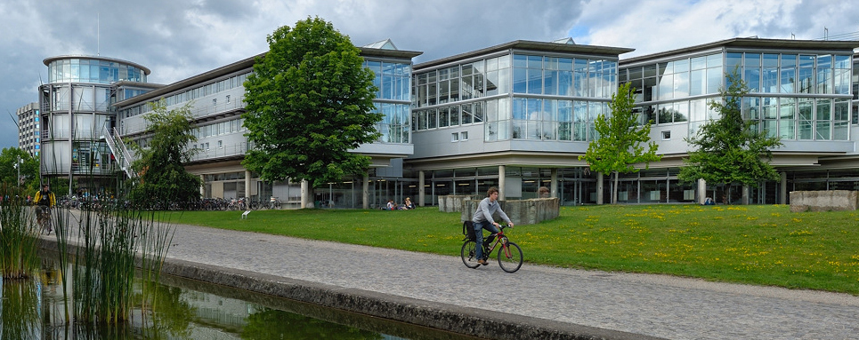
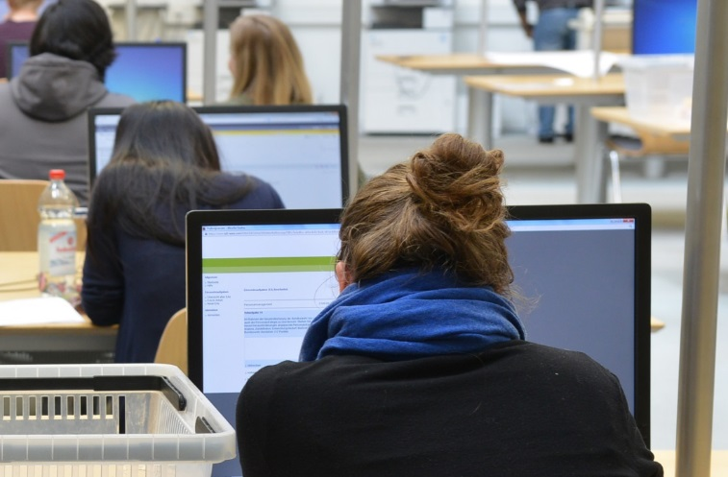
Lower Saxony State and University Library Highest Standard for Research and Teaching
Securing and expanding research and information infrastructures
Expansion of Open Access and electronic publication forms
Provision of information to students, educators, and researchers:
5.8 million books
1.5 million microforms
34,000 electronic journals
Extensive digital collections, and numerous maps, plans, manuscripts, and incunabula
Open-Access partnerships

Slide 25
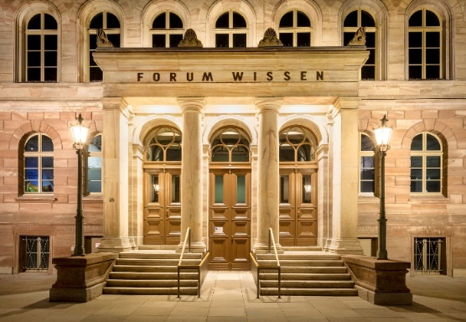
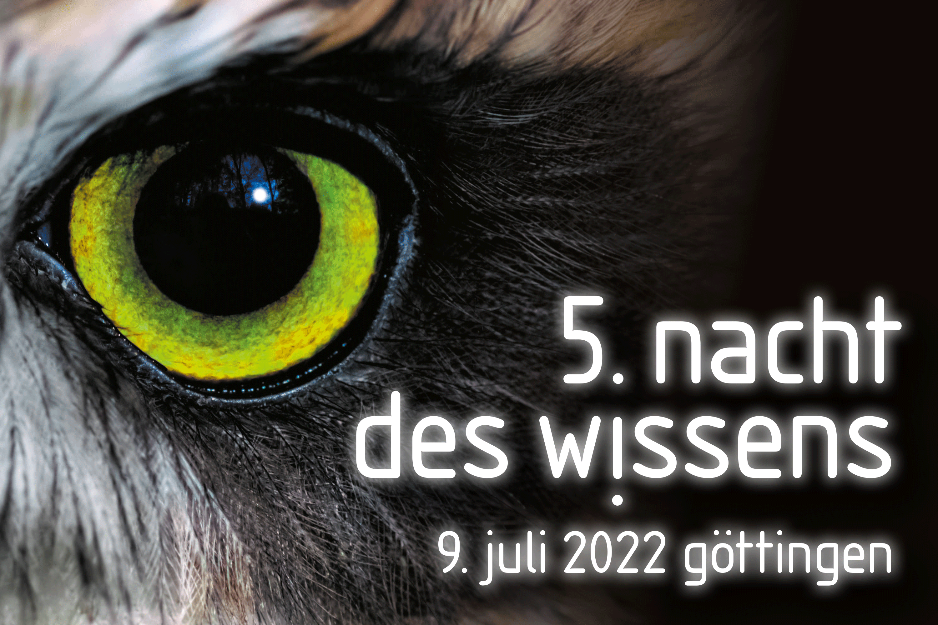
Science Explained
The Forum Wissen stands for dialogue between science and society. It is designed as
modern science museum
place of interdisciplinary research and teaching
center of the encounter between science and the general public.
The public's great interest in science is also reflected in the Göttingen Night of Knowledge, which was visited by more than 25,000 persons in 2022.

Slide 26
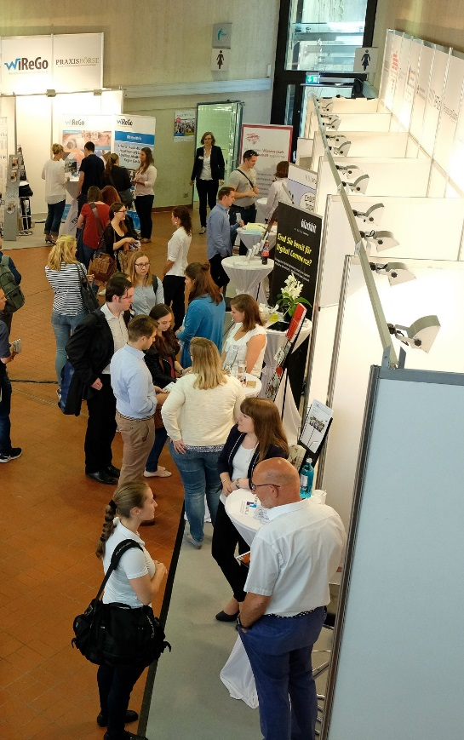
Science and Economy in Dialogue
The University promotes the integration of science and economy
The goal is to promote innovation through exchange between Students and companies about research projects
Qualification through practical experience
Direct access to scientific expertise
Mentoring by executives

Slide 27
Research Group

Slide 28
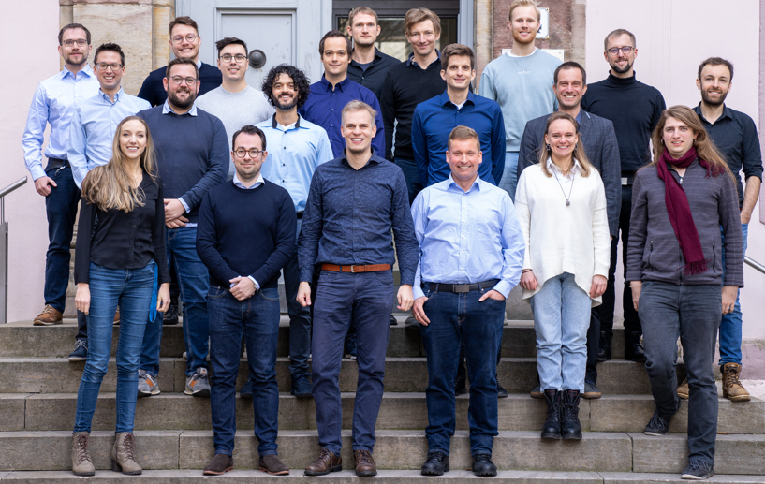
Gipp Lab - www.gipplab.org/team
Notes:
3 (7) postdocs, 11 doctoral researchers, 5 masters + Assistants and Rotation Projects

Slide 29
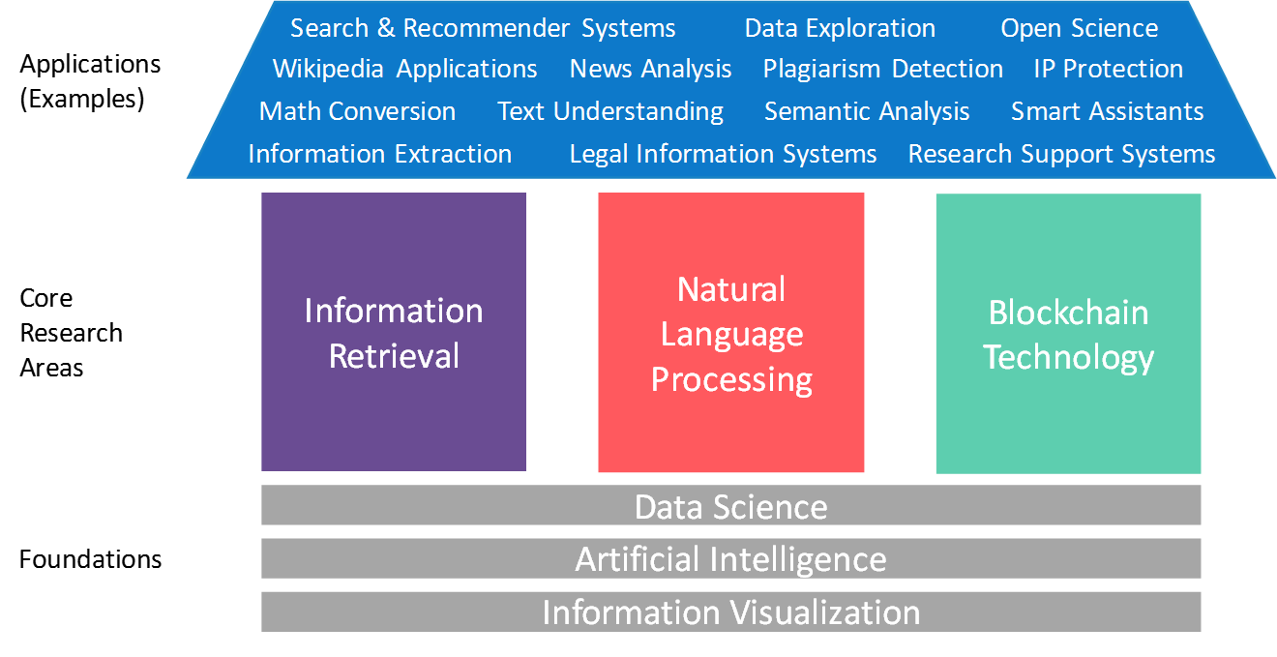
Gipp Lab- Research Topics
More

Slide 30
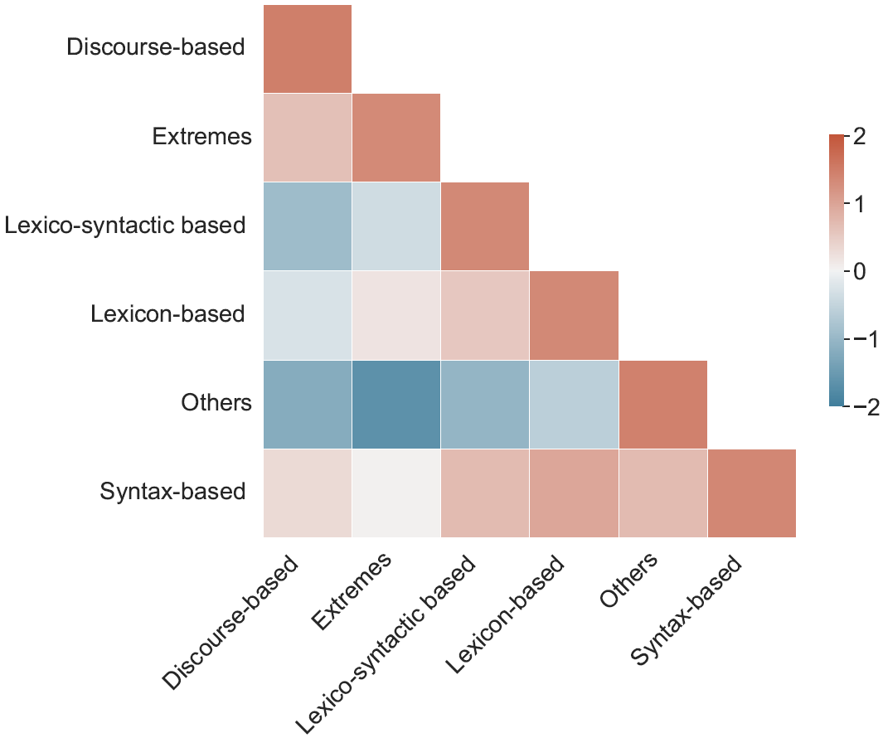
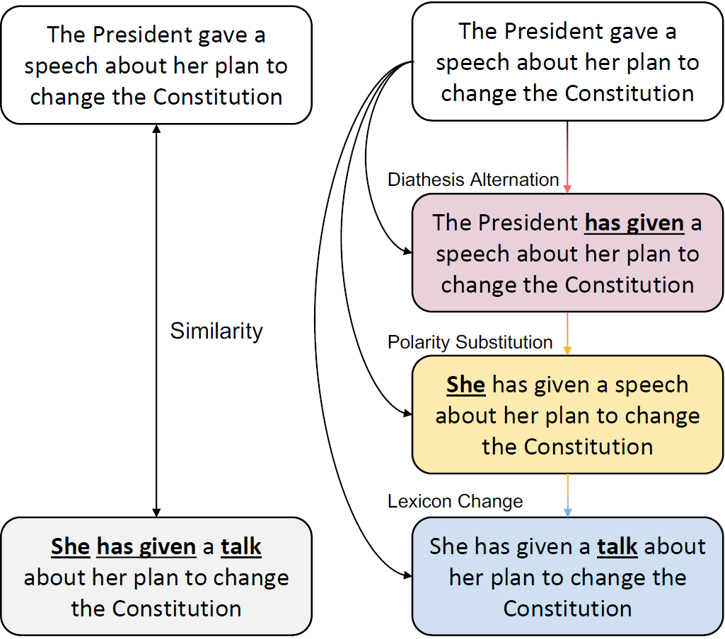
Applications
Paraphrase Generation and Detection

Slide 31
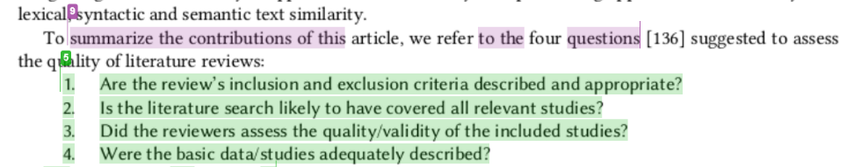
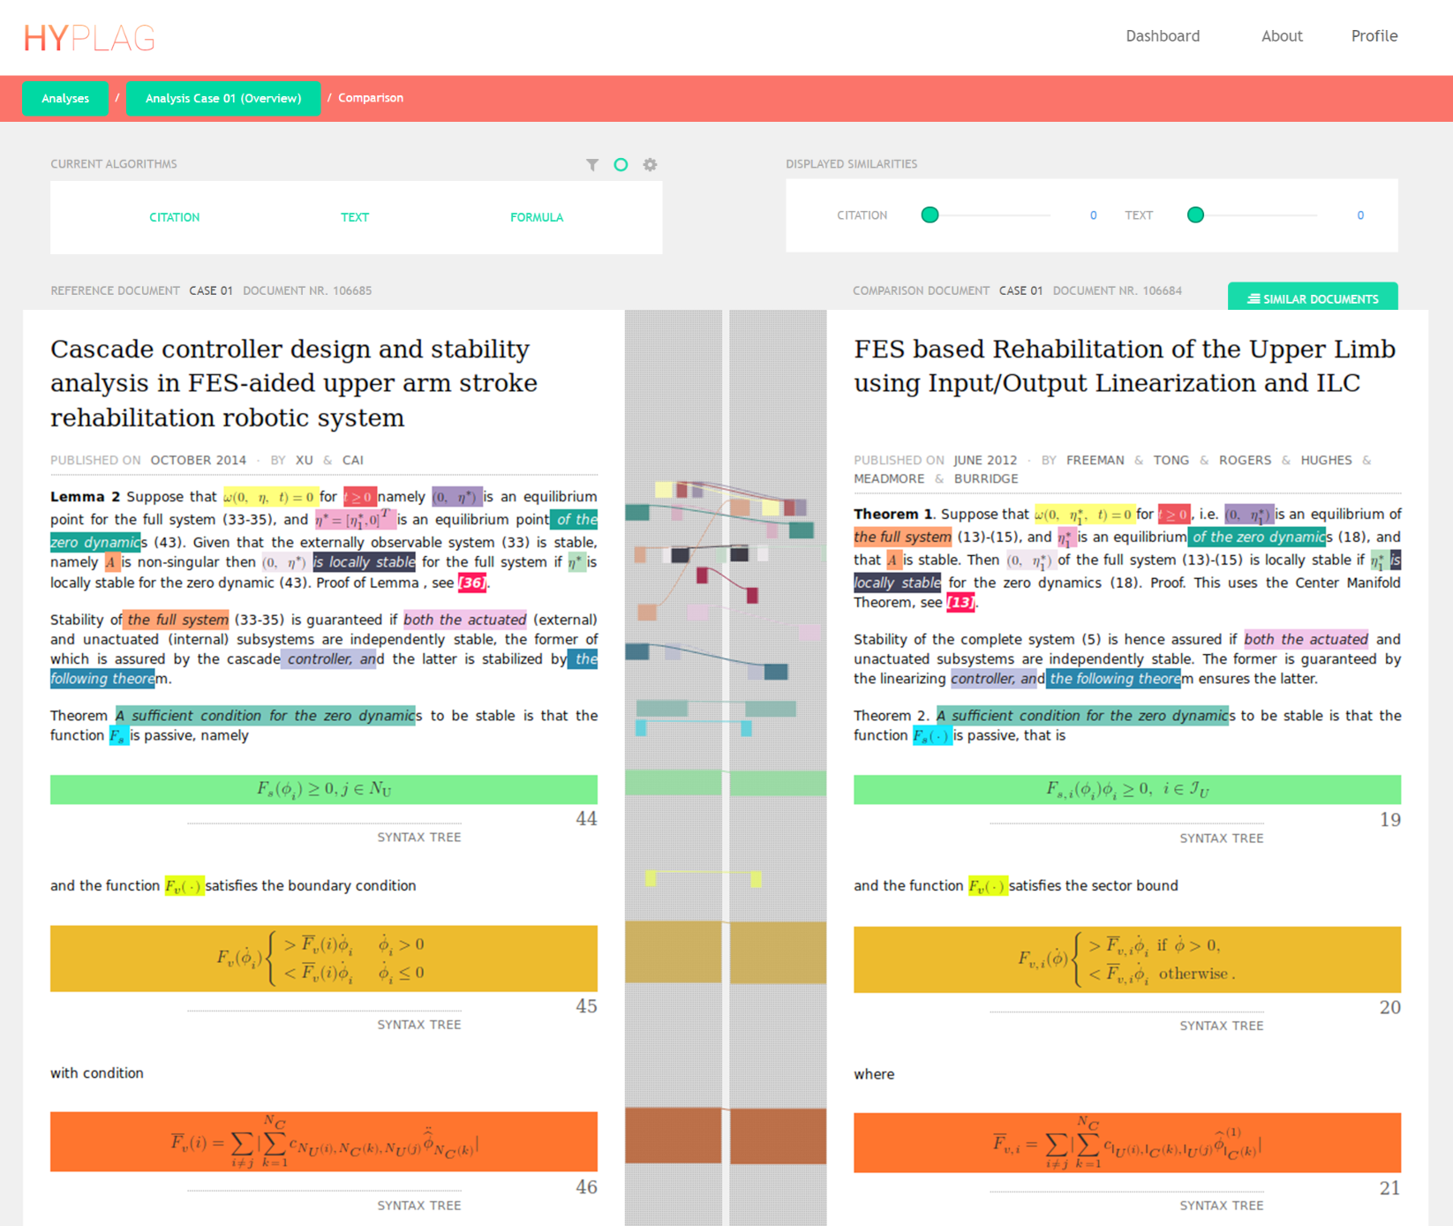
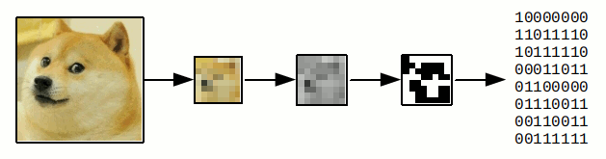
Applications
Plagiarism Detection

Slide 32
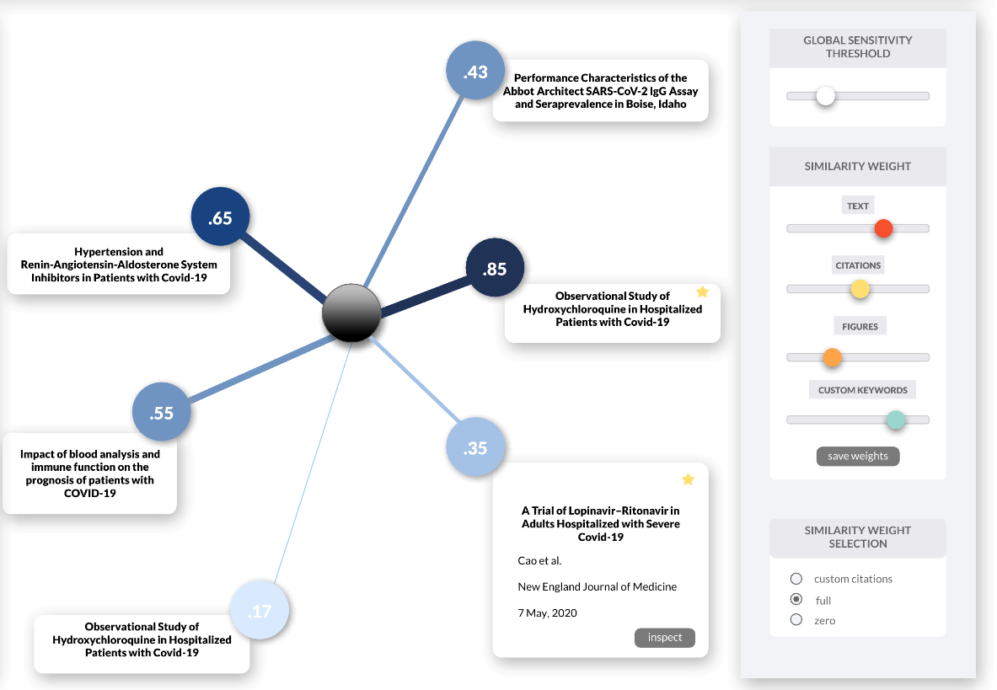
Applications
Literature Recommendation

Slide 33
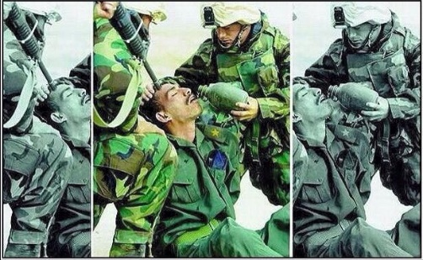
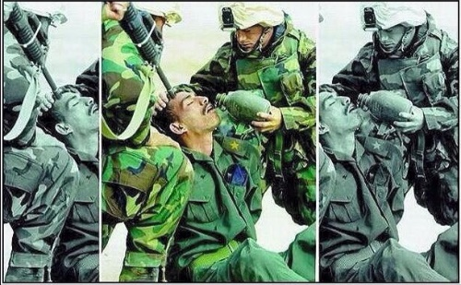
Applications
News Analysis
Objective
Frame 1
Frame 2
Hurricane Katrina, 2005

Slide 34
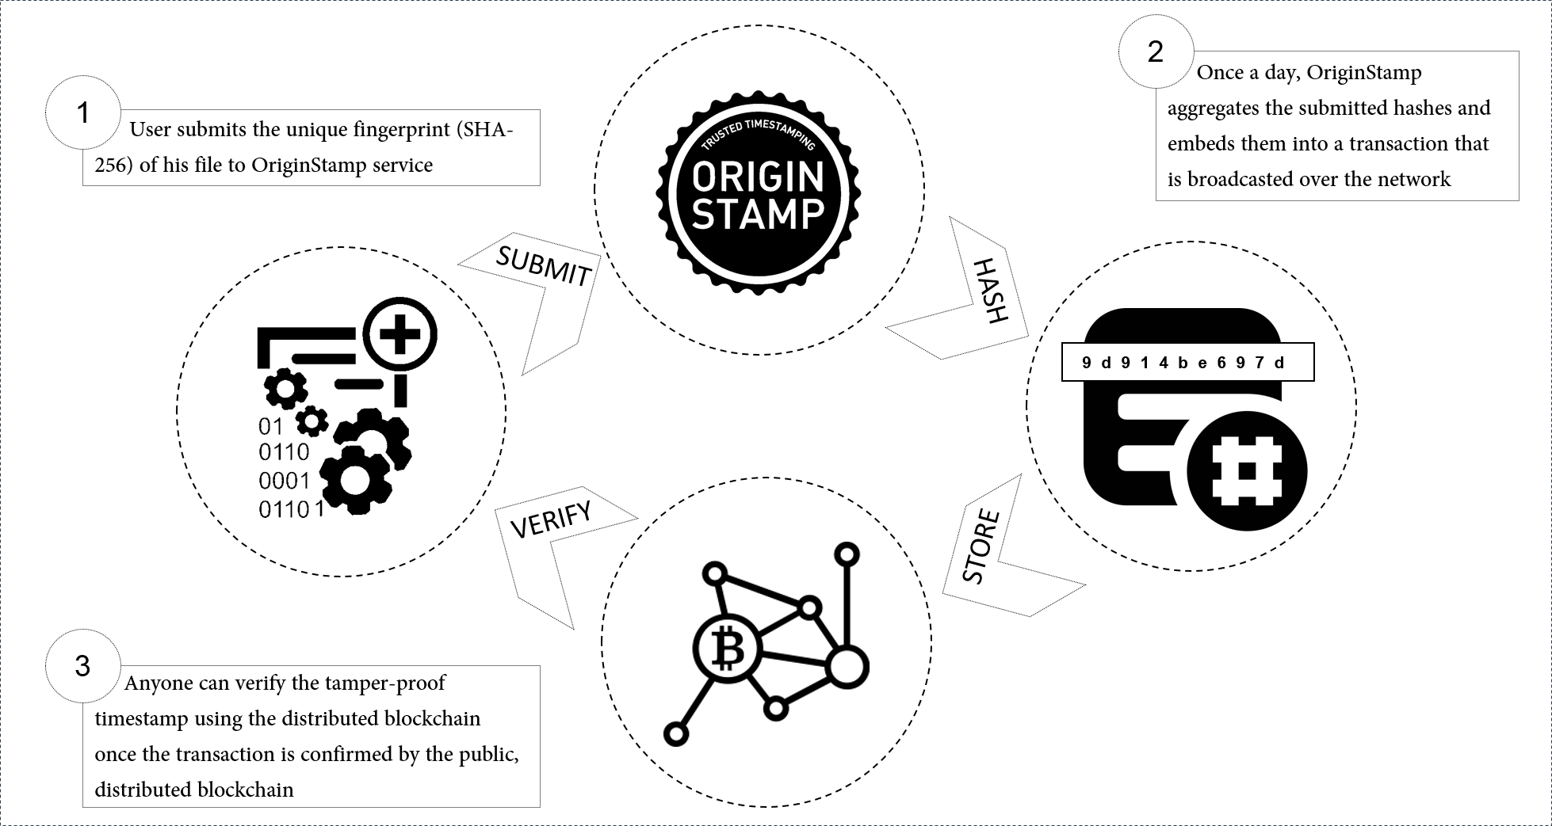
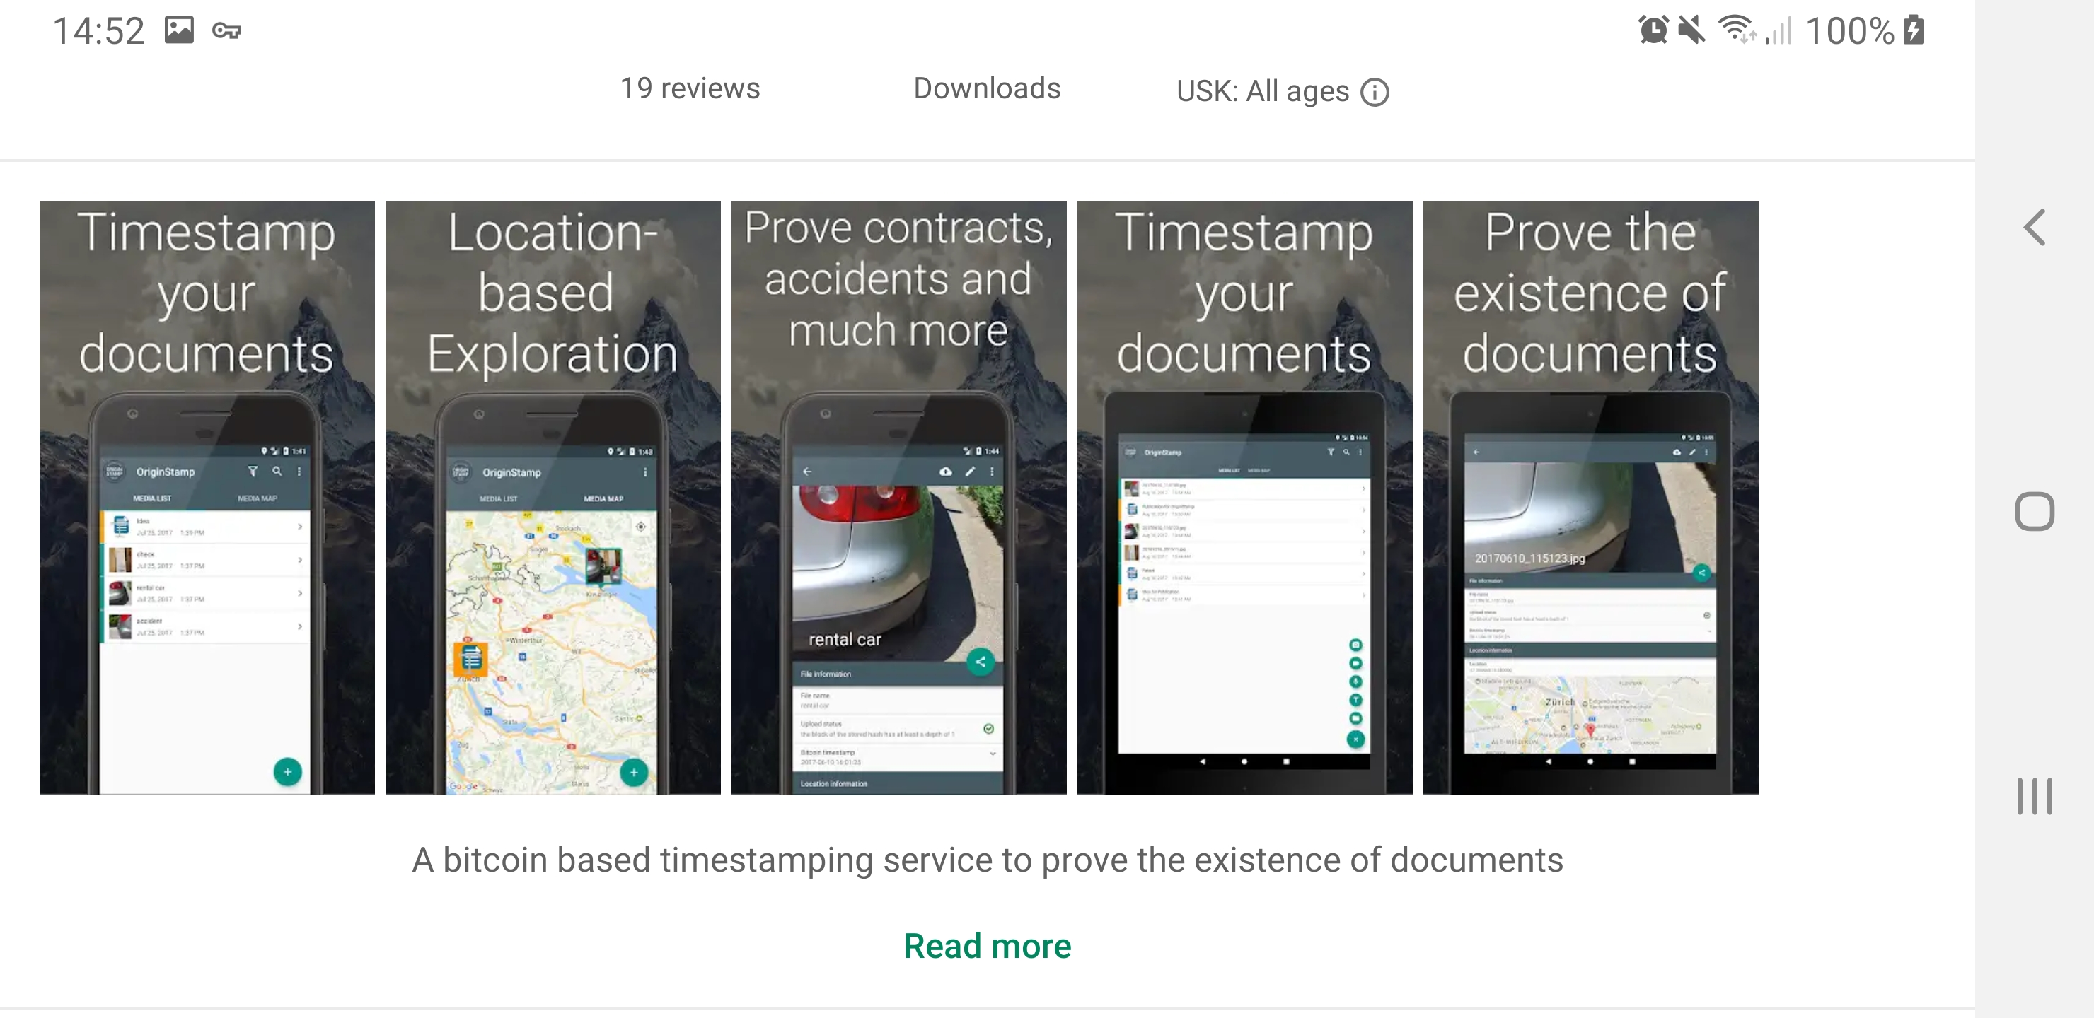
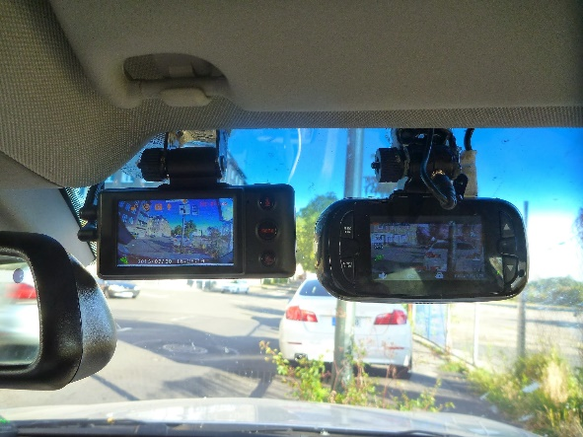
Applications
IP Protection

Slide 35
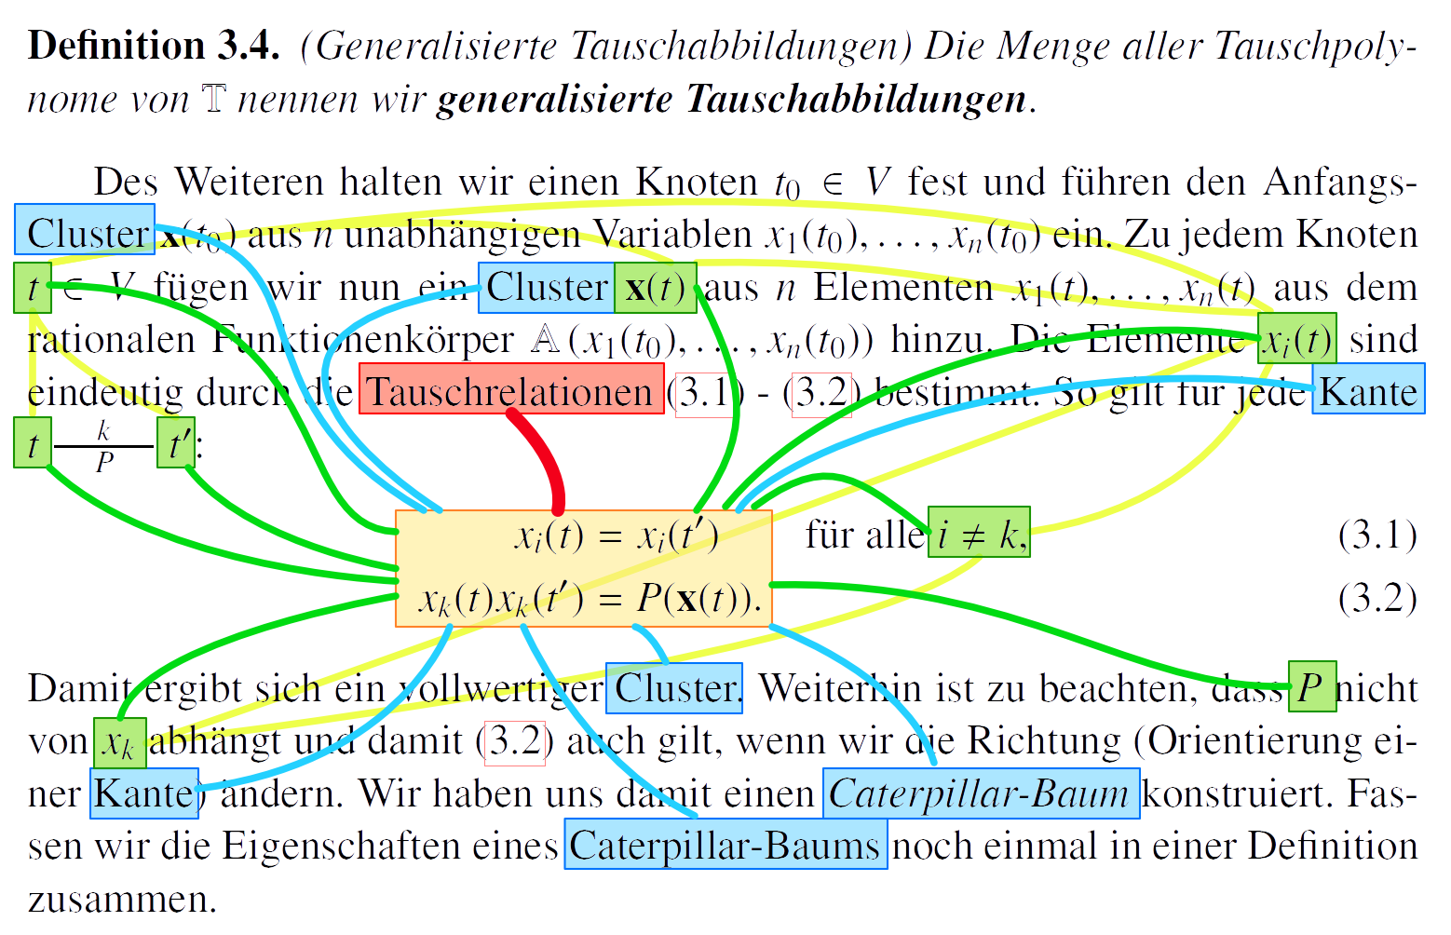
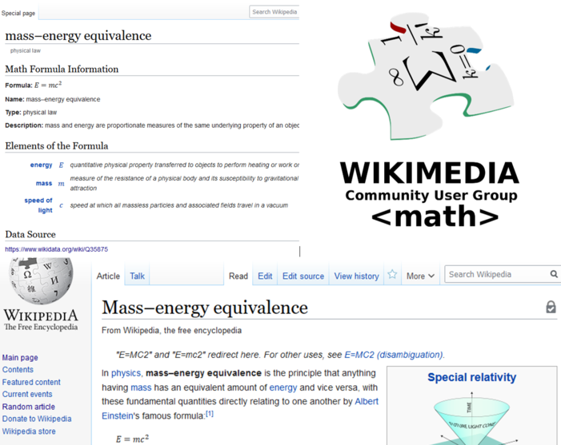
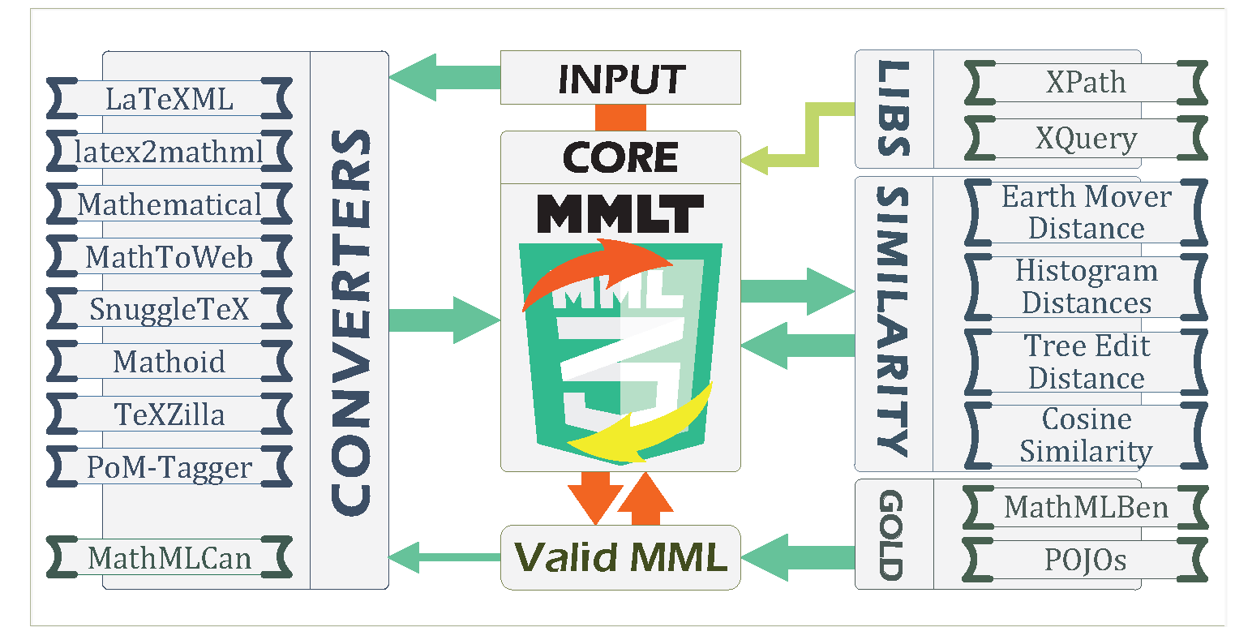
Applications
Math Information Retrieval

Slide 36
Applications
Applications
Information Retrieval
Natural Language Processing
Blockchain Technology
Core Research Areas
Data Science
Foundations
Artificial Intelligence
Information Visualization
For more projects and areas please visit https://gipplab.org/projects/

Slide 37

Research Areas

Slide 38
Research areas
Media Bias
Paraphrase Generation and Detection
Document Classification
WSD
Scientometrics and others
Text Similarity
Text Gen. and Sum.

Slide 39
Research areas
Paraphrase Generation and Detection
Media Bias
WSD
Semantic Features
Document Classification
Text Gen. and Sum.
Scientometrics and others
Text Similarity

Slide 40
Research areas
Paraphrase Generation and Detection
Media Bias
WSD
Semantic Features
Document Classification
Text Gen. and Sum.
Scientometrics and others
Text Similarity

Slide 41
WSD/Text Similarity
Multi-sense embeddings through a word sense disambiguation process, ESWA, Elsevier’19
Incorporating Word Sense Disambiguation in Neural Language Models, arXiv’21
Enhanced word embeddings using multi-semantic representation through lexical chains, IS, Elsevier’20
Pairwise Multi-Class Document Classification for Semantic Relations between Wikipedia Articles, JCDL’20
Aspect-based Document Similarity for Research Papers, COLING’20
Specialized Document Embeddings for Aspect-Based Similarity of Research Papers, JCDL’22
Supervised Disentangled Document Representations for Aspect based Similarity of Research Paper*, IJDL’23
Word similarity
Segment similarity
Document-aspect-based similarity using neural language models

Slide 42
Paraphrase Generation and Detection
Detecting Machine-Obfuscated Plagiarism, iConf’21
Are Neural Language Models Good Plagiarists? A Benchmark for Neural Paraphrase Detection, JCDL’21
Identifying Machine-Paraphrased Plagiarism, iConf’22
How Large Language Models are Transforming Machine-Paraphrased Plagiarism, EMNLP’22
Paraphrase Types for Generation and Detection*, EMNLP’23
Non-neural paraphrase detection
Neural paraphrase generation and detection
Paraphrase generation and detection with LLM
Paraphrase Types

Slide 43
Text Summarization
Analyzing Multi-Task Learning for Abstractive Text Summarization, GEM@EMNLP’22
Challenges in Meeting Summarization: A Qualitative Review and Empirical Study*, EMNLP’23
Multi-Source Meeting Summarization (in progress)
Multi-source summarization

Slide 44
Scientometrics, Mathematics, and others
Math-word embedding in math search and semantic extraction, Scientometrics’20
CS-Insights: A System for Analyzing Computer Science Research, arXiv’22
D3: A Massive Dataset of Scholarly Metadata for Analyzing the State of Computer Science Research. LREC’22
The Elephant in the Room: Analyzing the Presence of Big Tech in Natural Language Processing Research, ACL’23
We are Who We Cite: Examining the Bridges of Influence Between NLP and Other Academic Fields* EMNLP’23
AI Usage Cards: Responsibly Reporting AI-generated Content*, arXiv.EMNLP’23
Mathematics and Word Embeddings
Scientometrics – Datasets and System
Responsible AI

Slide 45
Media Bias
Testing the Generalization of Neural Language Models for COVID-19 Misinformation Detection, iConf’22
A Domain-adaptive Pre-training Approach for Language Bias Detection in News, JCDL’22
Neural Media Bias Detection Using Distant Supervision With BABE - Bias Annotations By Experts, EMNLP’21
Introducing MBIB - the first Media Bias Identification Benchmark Task and Dataset Collection, SIGI’23
Exploiting Transformer-based Multitask Learning for the Detection of Media Bias in News Articles, iConf’22
MAGPIE: Multi-Task Media-Bias Analysis Generalization for Pre-Trained Identification of Expressions*, EMNLP’23
The Media Bias Taxonomy: A Systematic Literature Review on the Forms and Automated Detection of Media Bias, ACM CSUR’23
Media Bias Detection
Media Bias Datasets
Multi-Task in Media Bias Detection
Media Bias Literature Review

Slide 46
Research

Slide 47
“NLP in a Nutshell”
<1990
90’s
to 00’s
>2000
Rule-Based
Statistical and Machine Learning
Neural Network Models

Slide 48
“NLP in a Nutshell”
<1990
90’s
to 00’s
>2000
Statistical and Machine Learning
Neural Network Models
Rule-Based

Slide 49
“NLP in a Nutshell”
Neural Language Models
2003
<1990
90’s
to 00’s
>2000
Statistical and Machine Learning
Neural Network Models
Rule-Based

Slide 50
“NLP in a Nutshell”
Neural Language Models
2003
<1990
90’s
to 00’s
>2000
Statistical and Machine Learning
Neural Network Models
2013
Rule-Based
Word2vec – Dense word embeddings

Slide 51
“NLP in a Nutshell”
Neural Language Models
2003
Attention is All you Need - Transformers
<1990
90’s
to 00’s
>2000
2017
Statistical and Machine Learning
Neural Network Models
2013
Rule-Based
Word2vec – Dense word embeddings

Slide 52
“NLP in a Nutshell”
Neural Language Models
2003
Attention is All you Need - Transformers
<1990
90’s
to 00’s
>2000
2017
T5, GPT-3
2020
2019
2022
Statistical and Machine Learning
Neural Network Models
2013
Rule-Based
ChatGPT
BERT
Word2vec – Dense word embeddings
*Pre-prints on arXiv for BERT and T5 were available at the end of 2018 and 2019 respectively.

Slide 53
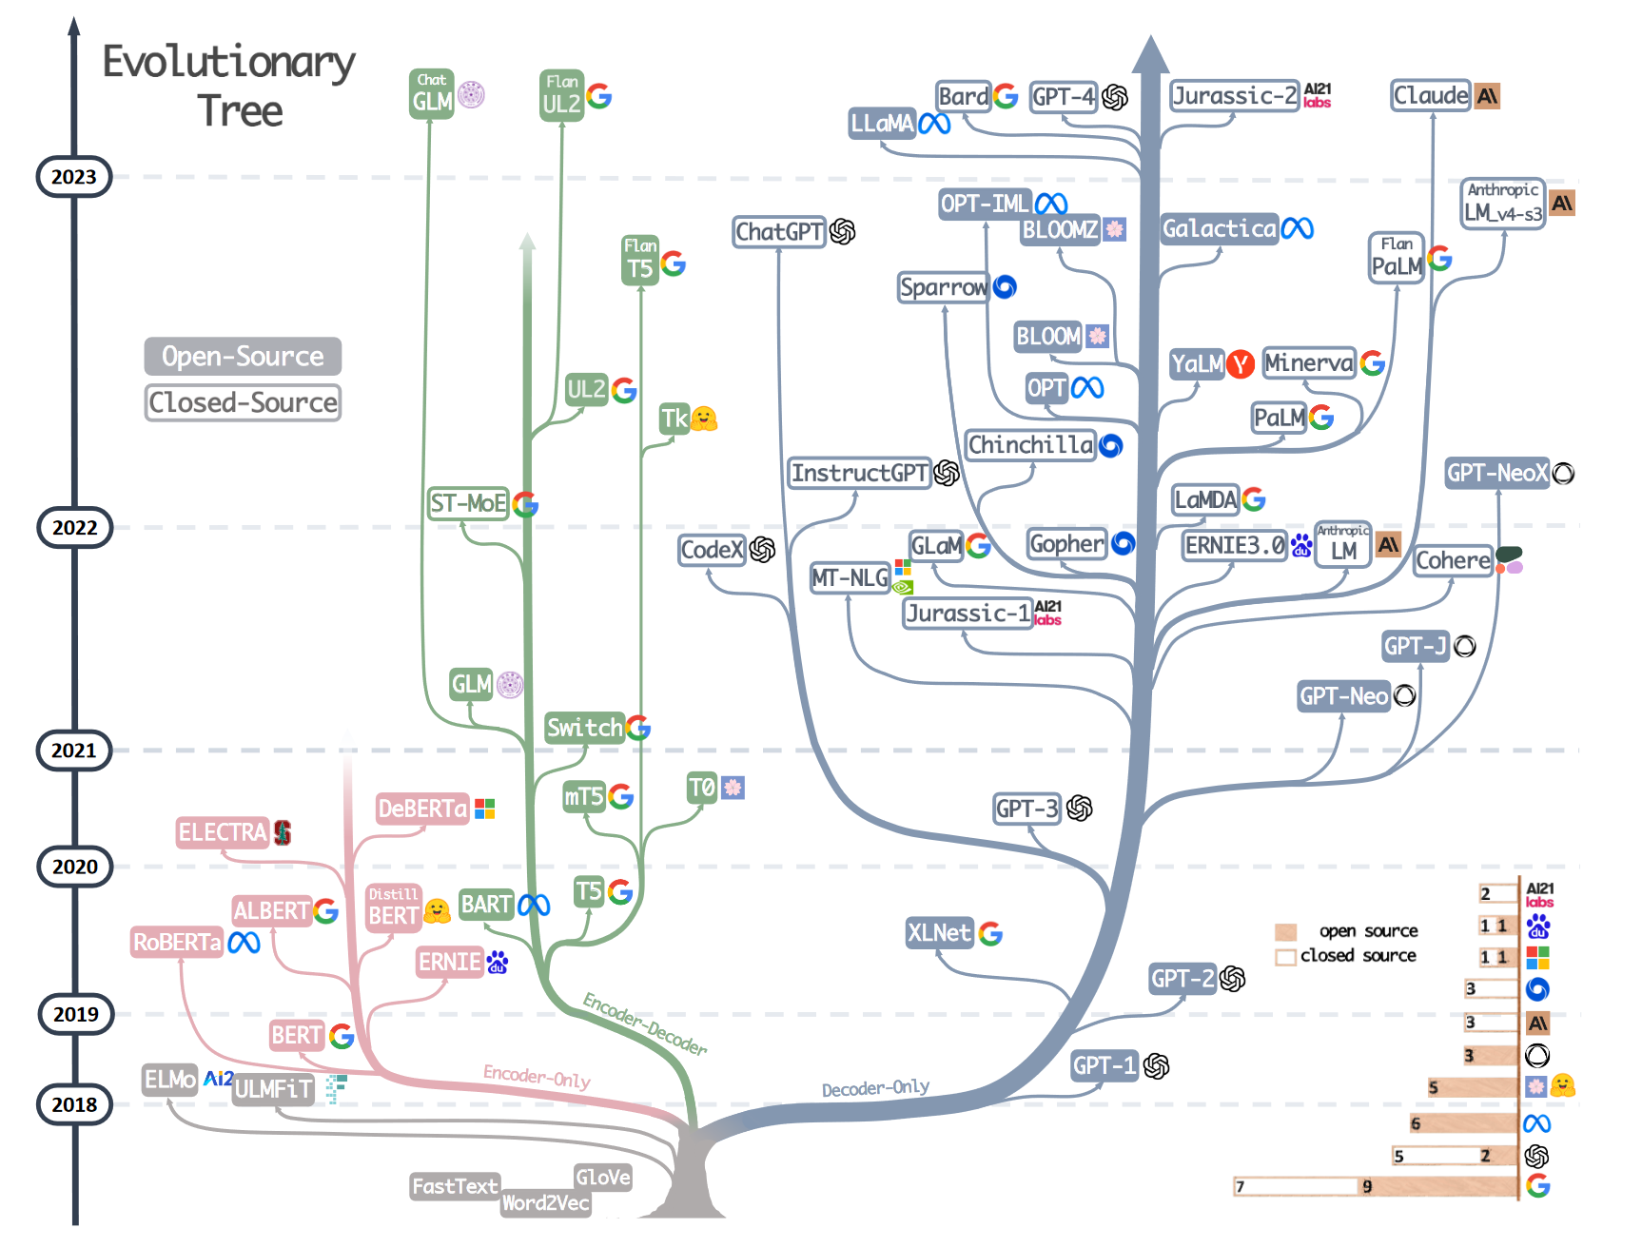
“NLP in a Nutshell”
[Source]
Notes:
Harnessing the Power of LLMs in Practice: A Survey on ChatGPT and Beyond

Slide 54

Paraphrase Generation and Detection

Slide 55
Paraphrase Generation and Detection
Detecting Machine-Obfuscated Plagiarism, iConf’20
Are Neural Language Models Good Plagiarists? A Benchmark for Neural Paraphrase Detection, JCDL’21
Identifying Machine-Paraphrased Plagiarism, iConf’22
How Large Language Models are Transforming Machine-Paraphrased Plagiarism, EMNLP’22
Paraphrase Types for Generation and Detection*, EMNLP’23
Non-neural paraphrase detection
Neural paraphrase generation and detection
Paraphrase generation and detection with LLM
Paraphrase Types

Slide 56
Paraphrase Generation and Detection
Paraphrasing
Paraphrases are texts expressing identical meanings but using different words or structures
Paraphrases exhibit human language's complex nature and diversity, as there are infinite ways to transform one text into another without changing its meaning.
Plagiarism
The use of ideas, content, or structures without appropriately acknowledging the source to benefit in a setting where originality is expected

Slide 57
Paraphrase Generation and Detection
morphology: “Who they could might be.”
syntax: “He drew a go was drawn by him.”
lexicon: “She liked enjoyed it.”
Notes:
Morphology studies the internal structure of words and their meaningful parts.
Syntax studies how words, phrases, and clauses are structured to form complex sentences.

Slide 58
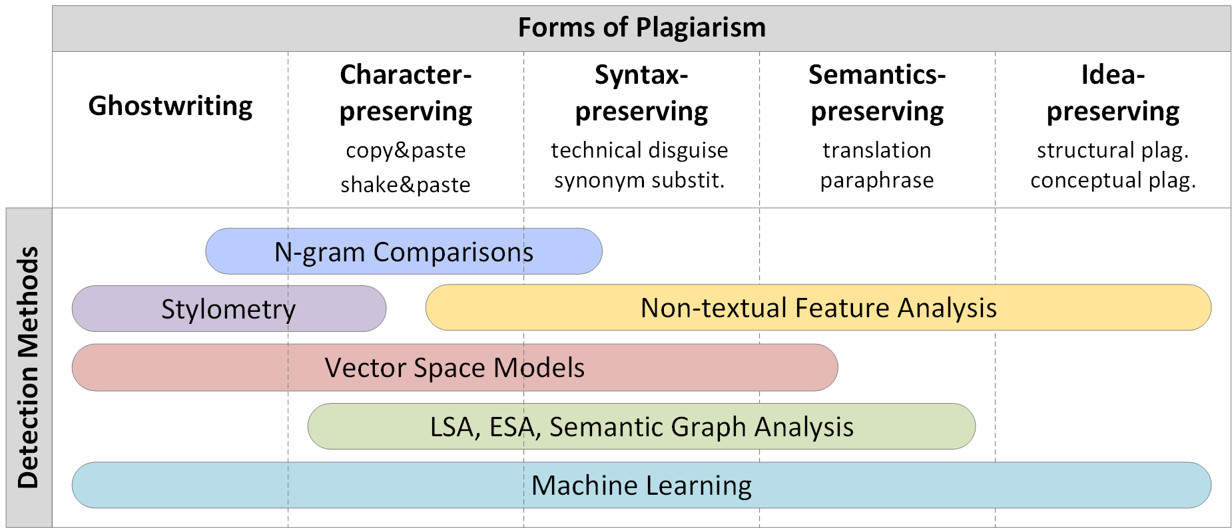
Paraphrase Generation and Detection
[Source]
Notes:
Tomáš Foltýnek, Norman Meuschke, and Bela Gipp. 2019. Academic Plagiarism Detection: A Systematic Literature Review. ACM Comput. Surv. 52, 6, Article 112 (October 2019), 42. DOI: https://doi.org/10.1145/3345317 LSA: Latent semantic analysis: LSA: Paraphrase detection using LSA involves comparing the vector representations of two sentences or phrases
ESA: explicit semantic analysis

Slide 59
Paraphrase Generation and Detection
Analyzed the performance of pre-trained word embedding models that convert texts into fixed-length vectors (features)
Word2vec, GloVe, fastText, Universal Sentence Encoder, (doc2vec) Paragraph Vectors
Machine Learning classifiers
Logistic regression, random forest, kNN, Support Vector Machine, Naïve Bayes
Evaluations
Documents and paragraphs
Human evaluation
Turnitin evaluation

Slide 60
Paraphrase Generation and Detection
Corpus
Wikipedia featured articles
Featured articles have numerous authors and undergo many revisions
Wide range of topics
breadth and depth
Superior quality as featured articles
approx. 0.1% of all articles
Machine Paraphrase Tool
SpinBot
Dataset split and details
Split | Documents |  | Paragraphs
 | Orig. | Parap. | Orig. | Parap.
Train | 4,012 | 4,012 | 98,282 | 102,485
Test | 1,990 | 1,990 | 39,241 | 40,729
Notes:
After spun we kept only documents with 3 or more sentences

Slide 61
Paraphrase Generation and Detection
Pre-trained word embedding models
Algorithm | Main Characteristic | Training Corpus | Dimensions
GloVe | Word co-occurrence | Wikipedia 2014 + Gigaword | 300
word2vec | Continuous BOW (CBOW) | Google News | 300
Paragraph Vectors | Distributed BOW (DBOW) | Wikipedia 2010 | 300
fastText-rw | Skip-gram without sub-words | Wikipedia 2017 + UMBC | 300
fastText-sw | Skip-gram with sub-words | Wikipedia 2017 + UMBC | 300
USE | Deep Average Network | Wikipedia + various soruces | 512
Notes:
Pre-trained models

Slide 62
Paraphrase Generation and Detection
Classifier | Main Characteristic | Dimensions
kNN | neighbors | 1, 5, 15, 25,…, 95
Logistic Regression (LR) | solver maximum iteration multiclass tolerance | newton-cg, lbfs, sag, saga 500, 1000, 1500 ovr, multinomial 0.01, 0.001, 0.0001, 0.00001
Support Vector Machine (SVM) | kernel gamma polynomial degree C | linear, radial bases function, polynomial 0.01, 0.001, 0.0001, 0.00001 1, 2, 3, 4, 5, 6, 7, 8, 9 1, 10, 100
Random Forest (RF) | number of estimators maximum features maximum depth minimum samples split minimum samples leaf | 100, 325, 550, 775, 1000 auto, sqrt 10, 32, 77, 100, None 2, 5, 10 1, 2, 4
Notes:
We also did Naïve Bayes, but there is no parameter

Slide 63
Paraphrase Generation and Detection
Automated evaluation – document level accuracy
Classifier | GloVe | word2vec | PV-DBOW | fastText-rw | fastText-sw | USE
kNN | 0.8874 | 0.9085 | 0.8867 | 0.8920 | 0.7696 | 0.8525
RF | 0.9085 | 0.9397 | 0.9606 | 0.9246 | 0.8791 | 0.8533
LR | 0.9457 | 0.9563 | 0.9829 | 0.9191 | 0.6950 | 0.7734
SVM | 0.9716 | 0.9744 | 0.9900 | 0.9789 | 0.9518 | 0.9437
NB | 0.7427 | 0.7437 | 0.8829 | 0.7492 | 0.6920 | 0.7455
Notes:
Boldface indicates the best value of a row.
Underlining indicates the best value of a column.

Slide 64
Paraphrase Generation and Detection
Automated evaluation – paragraph level accuracy
Classifier | GloVe | word2vec | PV-DBOW | fastText-rw | fastText-sw | USE
LR | 0.7758 | 0.8050 | 0.5806 | 0.7757 | 0.6068 | 0.6615
SVM | 0.7908 | 0.8225 | 0.5244 | 0.8336 | 0.7896 | 0.7815
NB | 0.5390 | 0.5163 | 0.5094 | 0.5229 | 0.5297 | 0.5519
Notes:
Boldface indicates the best value of a row.
Underlining indicates the best value of a column.

Slide 65
Paraphrase Generation and Detection
Human Analysis
10 featured articles
73 subjects
From 2min 12s to 36min 51s
Report (Human-H)
”I paid special attention to any oddness in the text. I never read student works so carefully.”
Notes:
Using the PDS, we checked ten machine-paraphrased articles selected at random from the document test set. In all cases, Turnitin found the correct source. The reported text similarity ranged between 49% and 67%, with an average of 55.2%
Turnitin, the system found a 100% match with the source. However, for the two machine-paraphrased versions of the paragraph, Turnitin computed a similarity score of zero for the source.
Wikipedia featured articles
Featured articles have numerous authors and undergo many revisions
Wide range of topics
breadth and depth
Superior quality as featured articles
approx. 0.1% of all articles
Machine Paraphrase Tool
SpinBot

Slide 66
Paraphrase Generation and Detection
Turnitin Analysis
10 featured articles
Found the correct source for all document
Average similarity of 55.2%.
In a second experiment, we tested Turnitin’s detection effectiveness for 9 documents that mix original and machine-paraphrased text
3,000 words documents - 10% to 90% of machine-paraphrased text with the remainder being random text generated by an online generator
In a document that contained only one machine-paraphrased paragraph (298 words), Turnitin failed to identify the spun text
If a plagiarist employs paraphrase tools to paraphrase a few paragraphs, the resulting similarity is often below Turnitin’s threshold, thus causing the plagiarism to remain undetected.
Notes:
For the other documents, Turnitin correctly marks parts of the spun text as plagiarized but in 2 cases, fails to identify Wikipedia as the source.

Slide 67
Paraphrase Generation and Detection
Findings
Doc2vec (PV-DBOW) performs well at a document level
Its performance drops for paragraph classification
Too large (>7GB RAM; train is expensive)
Word2vec/fastText + SVM offer the best trade-off
Accuracy, computation time, and memory consumption
Generalizes better for documents, paragraphs, and classifiers
Online detector: https://purl.org/spindetector
Limitations
Wikipedia articles as a data source
SpinBot as our only paraphrase tool
Paraphrase tools are not free!
Notes:
We later extended this with other plagiarism detection tools and paraphrasing tools

Slide 68
Paraphrase Generation and Detection
Takeaways
The presented approach outperformed human experts in distinguishing original and machine-paraphrased text
We made our all data publicly available on DeepBlue
Corpus for document and paragraph
Human judgment evaluation (anonymized)
Vector representation of corpus
Machine Learning classifiers (all models)
We also published our Machine-Obfuscated detector at
https://purl.org/spindetector

Slide 69
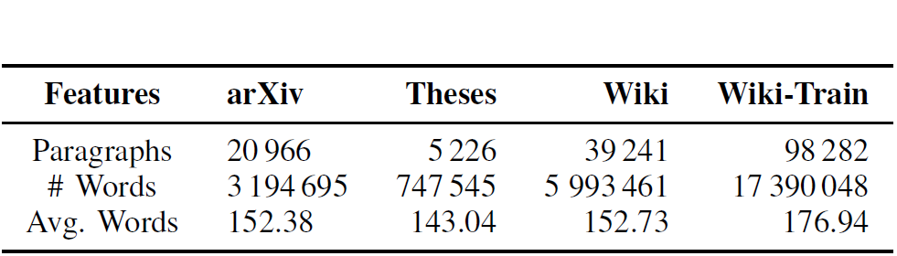
Paraphrase Generation and Detection

Slide 70
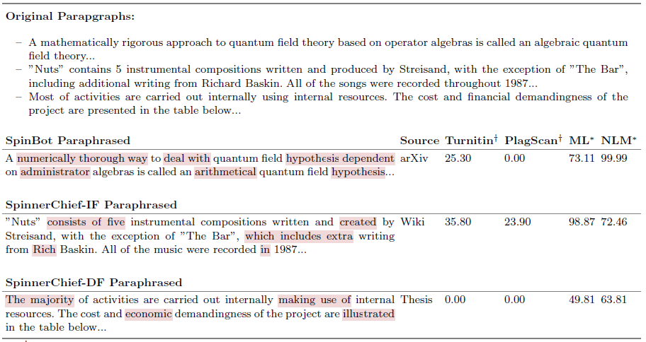
Paraphrase Generation and Detection
Notes:
An illustrative sample of three examples for each paraphrasing tool, data source, and classification method.
text-match in %.
prediction score in % for the best performing models Longformer and w2v+NB (see Sect. 4).
➣ Red background highlights changed tokens of the original version.
➣ Ellipsis (“...”) indicates the remainder of the paragraph.

Slide 71
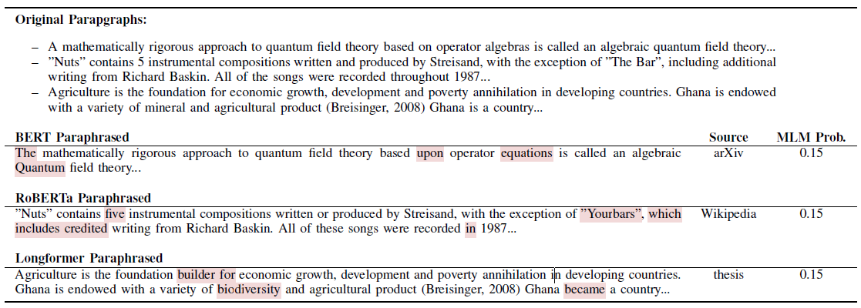
Paraphrase Generation and Detection
Notes:
AN ILLUSTRATIVE SAMPLE FOR EACH PARAPHRASING MODEL AND DATA SOURCE. RED BACKGROUND HIGHLIGHTS CHANGED TOKENS COMPARED TO
THE ORIGINAL VERSION. THE ELLIPSIS “...” INDICATES THE REMAINDER OF THE PARAGRAPH
Are Neural Language Models Good Plagiarists? A Benchmark for Neural Paraphrase Detection

Slide 72
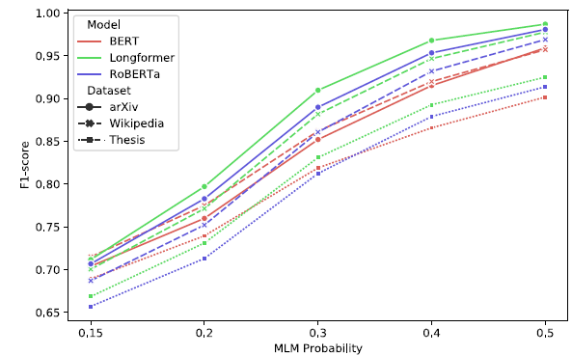
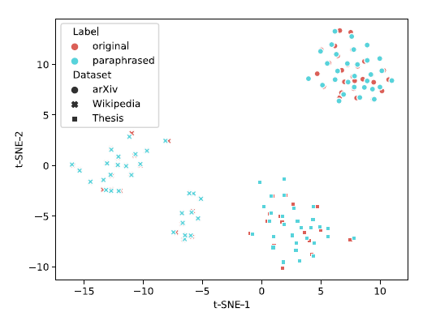
Paraphrase Generation and Detection
Notes:
Classification accuracy of fastText + SVM for neural-paraphrased test sets depending on masked language model probabilities. (left)
Two-dimensional representation of BERT embeddings for 30 original and paraphrased paragraphs from each source. The overlap of the embeddings suggests semantic equivalence of the original and paraphrased content. (right)

Slide 73
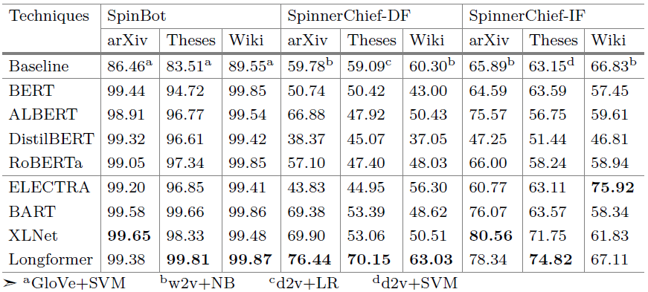
Paraphrase Generation and Detection
Notes:
Classification results (F1-Micro) of best ML techniques and neural language models for SpinBot and SpinnerChief.
The first horizontal block shows the best results of machine learning techniques, the
second of models that optimize BERT, and the third of models that use new architectural
or training approaches.
➣ Boldface indicates the best score for each test set.

Slide 74
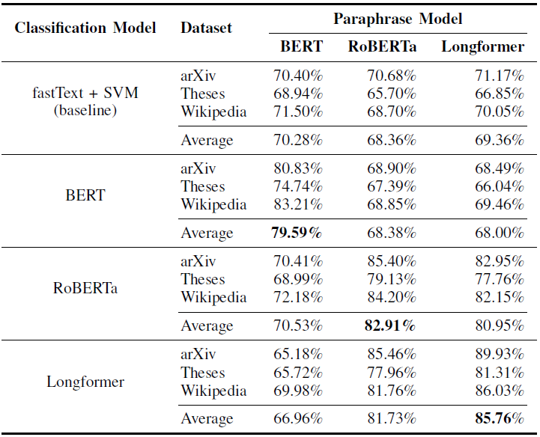
Paraphrase Generation and Detection
The paragraphs originate from arXiv papers, theses, and Wikipedia
All classification models performed best for Wikipedia articles
Maybe overlapping training corpus
Machine-paraphrased texts have a high semantic similarity to their original sources
Hard-to distinguish from human-like paraphrases.
Models are effective in identifying their own paraphrases
Transformers are comparable in classifying original and paraphrased content to static word embeddings (i.e., fastText)
Early evidence on the size of the model (against baseline)

Slide 75

Paraphrase Generation and Detection
We extracted paragraphs of articles from Wikipedia, arXiv and student theses
We paraphrased paragraphs using few-show prompts with GPT-3 and T5
Automated detection (7 methods)
Plagiarism detection software
Machine learning classifiers
Neural language models
Human detection (105 participants)
Classification
Text quality rating

Slide 76
Paraphrase Generation and Detection
Can humans identify whether a text is original, or machine-paraphrased?
Partially. As models grow large this gets really hard (almost random).
How do humans assess the quality of machine-paraphrased plagiarism?
Clarity and coherence are practically indistinguishable from the human (original) text for large models. Baseline (tools and base models) have worse quality
How do existing detection methods identify paraphrased plagiarism?
Models that generate the text are better at detecting them. Large models provide more realistic paraphrases.

Slide 77
Paraphrase Generation and Detection
Can humans identify whether a text is original, or machine-paraphrased?
Partially. As models grow large this gets really hard (almost random).
How do humans assess the quality of machine-paraphrased plagiarism?
Clarity and coherence are practically indistinguishable from the human (original) text for large models.
Baseline (tools and base models) have worse quality
How do existing detection methods identify paraphrased plagiarism?
Models that generate the text are (usually) better at detecting them.
Large models provide more realistic paraphrases.

Slide 78


Paraphrase Generation and Detection
Can humans identify whether a text is original, or machine-paraphrased?
How do humans assess the quality of machine-paraphrased plagiarism?

Slide 79

Paraphrase Generation and Detection
How do existing detection methods identify paraphrased plagiarism?
Simple paraphrase techniques can already fool standard tools
LLM are better in detection than the model used for paraphrase
Human detection is almost random for LLM paraphrasing
LLM already perform better than humans

Slide 80
Paraphrase Generation and Detection – Paraphrase Types
Can humans identify whether a text is original, or machine-paraphrased?
Most common negative rating reasons
Missing words or words not fitting the context
Lack of technical domain knowledge
Repetition or reusing syntax components
Main Contributions
We present a dataset with paraphrases from Wikipedia, arXiv and student theses.
We empirically evaluated the upcoming challenges for plagiarism detection
We show that GPT-3 provides the most realistic plagiarism
Limitations
Comparison of human generated to machine generated paraphrases
Lack of extrinsic plagiarism detection analysis

Slide 81
Paraphrase Generation and Detection – Paraphrase Types
The President gave a speech about her plan to change the Constitution
Notes:
Given the limitations of current paraphrase generation and detection tasks, their proposed solutions are also constrained.

Slide 82
Paraphrase Generation and Detection – Paraphrase Types
The President gave a speech about her plan to change the Constitution
She has given a talk about her plan to change the Constitution
Notes:
Given the limitations of current paraphrase generation and detection tasks, their proposed solutions are also constrained.

Slide 83
Paraphrase Generation and Detection – Paraphrase Types
The President gave a speech about her plan to change the Constitution
She has given a talk about her plan to change the Constitution
Notes:
Given the limitations of current paraphrase generation and detection tasks, their proposed solutions are also constrained.

Slide 84
Paraphrase Generation and Detection
“What is missing towards human-level AI? Systems that actually understand the variables they manipulate”
Yoshua Bengio, 2020

Slide 85
Paraphrase Generation and Detection – What is missing?

Slide 86
Paraphrase Generation and Detection – Paraphrase Types

Slide 87
Paraphrase Generation and Detection – Paraphrase Types
Most paraphrase-related tasks often focus on generating or classifying paraphrases at a general level
Paraphrased or original content
As tasks are shallow, their solutions are also limited
Detection systems are often not concerned with the aspects that make two texts segments alike
We propose two new tasks to explore the role of paraphrase types in current paraphrase tasks,
Paraphrase Type Generation
Paraphrase Type Detection
Notes:
Given the limitations of current paraphrase generation and detection tasks, their proposed solutions are also constrained.

Slide 88

Paraphrase Generation and Detection – Paraphrase Types
Notes:
Paraphrase Type Generation (left) and Paraphrase Type Detection (right) with model f, reference segments
s1, s2, s3 and candidate segments ˜s1, ˜s2, ˜s3.

Slide 89
Paraphrase Generation and Detection – Paraphrase Types

Slide 90

Paraphrase Generation and Detection – Paraphrase Types
Notes:
From ETPC

Slide 91

Paraphrase Generation and Detection – Paraphrase Types
Notes:
Spearman correlations between paraphrase types using word position deviation, lexical deviation, BLEU, iBLEU, ROUGE, and BERTScore in the ETPC dataset. Correlations are normalized using mean μ and standard deviation σ such that μ = 0, σ = 1
Paraphrased examples on ETPC

Slide 92
Paraphrase Generation and Detection – Paraphrase Types
Research Questions
How much are paraphrase types already represented in language models?
How does learning paraphrase types improve task performance of traditional paraphrase tasks with model scale?
How well can language models perform type generation and detection when instructed to?
What impact has learning paraphrase types on generating and identifying paraphrases?

Slide 93
Paraphrase Generation and Detection – Paraphrase Types
Research Questions
How much are paraphrase types already represented in language models?
The larger the models the better they are in identifying paraphrase types.
How does learning paraphrase types improve task performance of traditional paraphrase tasks with model scale?
Learning paraphrase types improves results on existing tasks consistently (without types).
How well can language models perform type generation and detection when instructed to?
Paraphrase types are harder. Prompting helps in both tasks, but finetuning is better.
What impact has learning paraphrase types on generating and identifying paraphrases?
Both tasks see improvements when being trained on paraphrase types. Positive transfer learning between datasets.

Slide 94

Paraphrase Generation and Detection – Paraphrase Types
How much are paraphrase types already represented in language models? (LLaMA;ETPC)
Notes:
Accuracy for identifying paraphrase types of six high-level groups for different model sizes in the ETPC dataset of LLaMA.
Did we fine tuned LLaMA here or it was out of box?

Slide 95

Paraphrase Generation and Detection – Paraphrase Types
How does learning paraphrase types improve task performance of traditional paraphrase tasks with model scale? (LLaMA;ETPC)
Notes:
Task performance (F1-scores) on ETPC for different model sizes of LLaMA with and without learned
paraphrase types against human performance as reported by the respective datasets or benchmarks.
Twitter News URL Corpus is a human-labeled paraphrase corpus to date of 51,524 sentence pairs
Quora Question Pairs (QQP) dataset consists of over 400000 question pairs, and each question pair is annotated with a binary value indicating whether the phrase is paraphrased or not
Paraphrase Adversaries from Word Scrambling (PAWS) is a dataset contains 108,463 human-labeled and 656k noisily labeled pairs that feature the importance of modeling structure, context, and word order information for the problem of paraphrase identification.

Slide 96

Paraphrase Generation and Detection – Paraphrase Types
How does learning paraphrase types improve task performance of traditional paraphrase tasks with model scale? (Details)

Slide 97

Paraphrase Generation and Detection – Paraphrase Types
How well can language models perform type generation when instructed to? (ETPC)
Unconstrained: how well models generate paraphrases directly ``out-of-the-box'' without instructions
Guided: how accurately untrained state-of-the-art models can generate paraphrase types based on prompt instructions
Fine-Tuned: how fine-tuned models perform in generating paraphrase types
Notes:
Generation results on the ETPC dataset
This indicates that BART and PEGASUS are responsive to instruction prompts. However, they still struggle to generate requested paraphrase types.

Slide 98

Paraphrase Generation and Detection – Paraphrase Types
What impact has learning paraphrase types on generating paraphrases?
Generation results on the QQP dataset for trained models in the ETPC without and with prior paraphrase type generation training. Best results in bold.
Notes:
How iB is calculated?

Slide 99

Paraphrase Generation and Detection – Paraphrase Types
What impact has learning paraphrase types on identifying paraphrases?
Detection results for the ETPC (accuracy) and QQP (accuracy/F1) datasets.
Models trained on ETPC are applied in QQP (w/ Types). Best results in bold.
Notes:
∗Official results (w/o Types) from GLUE leaderboard https://gluebenchmarkcom/leaderboard for comparison.

Slide 100

Paraphrase Generation and Detection – Paraphrase Types
What impact has learning paraphrase types on identifying paraphrases?
Detection results for the ETPC (accuracy) and QQP (accuracy/F1) datasets.
Models trained on ETPC are applied in QQP (w/ Types). Best results in bold.
Notes:
∗Official results (w/o Types) from GLUE leaderboard https://gluebenchmarkcom/leaderboard for comparison.

Slide 101
Paraphrase Generation and Detection – Paraphrase Types
Findings
Paraphrase types pose a more challenging scenario
Paraphrase types can be learned and generalized
Proposed tasks are compatible with traditional ones
Prompting can be used to improve paraphrase type generation (fine-tuning is better)
Learning paraphrase types is beneficial in the generation and detection tasks
With and without paraphrase types
Issues
Paraphrase types extracted/analyzed only on the ETPC dataset
Transfer learning only tested between ETPC and QQP
We still rely on standard metrics such as BLEU and ROUGE – and they are problematic
Human study is still necessary to evaluate the effects of paraphrase types
Notes:
These results underscore the value of integrating paraphrase types in enhancing models’ detection capabilities across different datasets and detection metrics.

Slide 102

Scientometrics and others

Slide 103
Scientometrics, Responsible AI, and others
Mathematics and Word Embeddings
Math-word embedding in math search and semantic extraction, Scientometrics’20
CS-Insights: A System for Analyzing Computer Science Research, arXiv’22
D3: A Massive Dataset of Scholarly Metadata for Analyzing the State of Computer Science Research. LREC’22
The Elephant in the Room: Analyzing the Presence of Big Tech in Natural Language Processing Research, ACL’23
We are Who We Cite: Examining the Bridges of Influence Between NLP and Other Academic Fields* EMNLP’23
AI Usage Cards: Responsibly Reporting AI-generated Content*, arXiv.EMNLP’23
Scientometrics – Datasets and System
Responsible AI

Slide 104

AI Usage Cards

Slide 105
Responsible AI
The indiscriminate use of AI can be potentially harmful
However, there is hope
Researchers and communities are concerned with the current state and future of AI in our daily lives
This is an ongoing debate, so we will go over some interesting initiatives
Datasheets for Datasets - Template
Model Cards for Model Reporting – Template
Ethics sheets for AI Tasks
If we can report the Datasets using Datasheets, the Models on Model Cards, and the Tasks Ethics sheets, what is missing?

Slide 106
Responsible AI
The indiscriminate use of AI can be potentially harmful
However, there is hope
Researchers and communities are concerned with the current state and future of AI in our daily lives
This is an ongoing debate, so we will go over some interesting initiatives
Datasheets for Datasets - Template
Model Cards for Model Reporting – Template
Ethics sheets for AI Tasks
If we can report the Datasets using Datasheets, the Models on Model Cards, and the Tasks Ethics sheets, what is missing?
What about the generated and altered content?

Slide 107
Responsible AI
The indiscriminate use of AI can be potentially harmful
However, there is hope
Researchers and communities are concerned with the current state and future of AI in our daily lives
This is an ongoing debate, so we will go over some interesting initiatives
Datasheets for Datasets - Template
Model Cards for Model Reporting – Template
Ethics sheets for AI Tasks
If we can report the Datasets using Datasheets, the Models on Model Cards, and the Tasks Ethics sheets, what is missing?
What about the generated and altered content?
AI Usage Cards: Responsibly Reporting AI-generated Content (ours)

Slide 108
Responsible AI – AI Usage Cards
AI Usage Cards: Responsibly Reporting AI-generated Content
(Wahle, J. et al., 2023)
We propose a model for the responsible use of AI content generation in science based on three dimensions: transparency, integrity, and accountability
A standardized tool to report/disclose the use of AI in scientific works.
It can be generated using an online questionnaire via a free service and exported in machine-readable formats that can be incorporated directly into any scientific work.
https://ai-cards.org/
Notes:
Jan Philip Wahle, Terry Ruas, Norman Meuschke, Saif M. Mohammad, and Bela Gipp

Slide 109





Responsible AI – AI Usage Cards
AI Usage Cards: Responsibly Reporting AI-generated Content (Wahle, J. et al., 2023)
They propose a model for the responsible use of AI content generation in science based on three dimensions: transparency, integrity, and accountability
A standardized tool to report using AI in scientific works.
It can be generated using an online questionnaire via a free service and exported in machine-readable formats that can be incorporated directly into any scientific work.
https://ai-cards.org/
Notes:
Jan Philip Wahle, Terry Ruas, Norman Meuschke, Saif M. Mohammad, and Bela Gipp

Slide 110

Responsible AI – AI Usage Cards

Slide 111
Responsible AI – AI Usage Cards
Transparency
Acknowledgment of the use of AI models in one's work
One should document every instance of using AI models
Disclose the information in a suitably summarized form
Similar practices are established for acknowledging a funding agency for supporting a project, individuals for giving feedback, an author affiliation, or a possible conflict of interest.
Establish traceability of the scientific process steps to which AI contributed and help authors reflect on which parts of their work have originated from AI

Slide 112
Responsible AI – AI Usage Cards
Integrity
Related to the correctness, truthfulness, fairness, safety, and appropriateness of the content generated by AI systems.
Verification of fairness principles has to be carried out through human assessment.
AI uses learnable parameters to model massive amounts of data from the internet
Users of this technology should reflect on such content and assert whether it propagates biases, factual incorrectness, other's ideas as own ideas, unethical statements, prejudice, personally identifiable information, or false claims towards individuals in their output.
This verification of fairness principles has to be carried out through human assessment*

Slide 113
Responsible AI – AI Usage Cards
Accountability
How researchers use, publish, and disseminate content produced with the help of AI models.
Ensure that generated content adheres to integrity proactively before releasing AI-generated content
Being open to feedback and willing to make changes as necessary
Being open about the model’s limitations and potential risks associated with its use
Without accountability, knowing what was manipulated can produce harm to individuals and does not lead to liability

Slide 114
Responsible AI – AI Usage Cards
Transparency
Acknowledgment of the use of AI models in one's work
One should document every instance of using AI models
Integrity
Related to the correctness, truthfulness, fairness, safety, and appropriateness of the content generated by AI systems.
Verification of fairness principles has to be carried out through human assessment.
Accountability
How researchers use, publish, and disseminate content produced with the help of AI models.
Ensure that generated content adheres to integrity proactively before releasing AI-generated content
Being open to feedback and willing to make changes as necessary
Being open about the model’s limitations and potential risks associated with its use

Slide 115
Responsible AI – AI Usage Cards
Responsibility
Each dimension is crucial for using AI in the scientific process – Three-leg chair
By acknowledging the use of models and holding authors accountable, the output can be explained, but it may still contain inaccuracies and biases since no verification steps have been taken.
It is the responsibility of both the AI user and creator to provide sources for the ideas presented, allowing readers to verify them.
If we acknowledge the usage of AI and approve its content, we achieve usability but can encounter a lack of accountability if problems occur, e.g., plagiarized content or misleading information.
The content is useable ``at your own risk'' due to a lack of accountability.
When accountability and integrity are verified, the output is secure because it has been affirmed. Still, we need to know where the use occurred.
Even if human flaws exist, they can be accounted for and adjusted if necessary.

Slide 116
Responsible AI – AI Usage Cards - Aspects
New: Content generated based on prompts without a significant portion of prior ideas and thoughts
Example Prompt: “Generate some ideas on how to approach the problem of memorization for large language models.”
Revise: Content generated based on previous content that has a significant portion of own ideas and thoughts.
Example Prompt: “Rephrase the following paragraph so that it uses academic voice, is concise and short, and adds an example of a meta-analysis.”
Compare: Content generated by providing two or more pieces of content (own or others).
Example Prompt: “Compare my definition of plagiarism to the following [...]”
Notes:
Our card allows researchers and practitioners to report AI usage during all phases of scientific work, from theoretical ideation to practical use.
This includes even formulating ideas, for example, in the form of questions and acquiring knowledge during a literature review.
Researchers can prompt AI to generate hypotheses, support the development of methods, and suggest newly designed experiments.

Slide 117
Responsible AI – AI Usage Cards
Project details: Meta-information about the authors, models, and project, including their names, versions, key applications, and affiliations.
Ideation and review: Support during theoretical preparation of the project through idea formulation (e.g., outline) and examining related work (e.g., comparing literature, finding analogies).
Methodology and experiments: Design, comparison, and generation of processes for methodological tasks during the project, optionally resulting in experiments (e.g., proposing a new process).
Writing and presentation: Generation and paraphrasing of text used in scientific reports or papers. The improvement of content, figures, tables and any other elements are also included.
Code and data: Manipulation, generation, refactoring, optimization, and analysis of code and data.
Ethics: Implications of using AI and steps to mitigate their possible errors and harms
Notes:
Our card allows researchers and practitioners to report AI usage during all phases of scientific work, from theoretical ideation to practical use.
This includes even formulating ideas, for example, in the form of questions and acquiring knowledge during a literature review.
Researchers can prompt AI to generate hypotheses, support the development of methods, and suggest newly designed experiments.

Slide 118

Responsible AI – AI Usage Cards
Responsibility
Only when we
Acknowledge the use of the model
Mitigate its inappropriate outputs; and
Assign someone to respond in case of problems or questions can we mitigate major issues and make AI usage responsible
Try it.

Slide 119

D3 and CS-Insights

Slide 120

D3 and CS-Insights
Notes:
The number of annual publications and authors in logarithmic scale between 1936 and 2021

Slide 121
D3 and CS-Insights
Computer Science (CS) is one of the most influential research fields
Data sources exist but are hard to explore
Google Scholar
DBLP
Semantic Scholar
DBLP misses semantic information (e.g., abstracts, bibliographies) from full-texts to understand trends in impact, content, or bias of CS research
Google Scholar and Semantic Scholar focus their platforms on authors and their metrics (e.g., h-index, number of papers, citations) but lack details on venues and publishers
SCOPUS and Web of Science are behind paywalls
NLP Scholar and NLPExplorer offer a more personalized solution but only focus on natural language processing (NLP) publications
Notes:
sentient information: responsive to or conscious of sense impressions. 2 : having or showing realization, perception, or knowledge : aware. 3 : finely sensitive in perception or feeling

Slide 122
D3 and CS-Insights
+6 million publications focused on CS journals and conferences
32 features: venues, citations, affiliations, ...
Lightweight: 3.5GB compressed
Abstracts and titles enable semantic analysis

Slide 123

D3 and CS-Insights
Website: https://cs-insights.uni-goettingen.de/
Repository: https://github.com/jpwahle/cs-insights

Slide 124

D3 and CS-Insights

Slide 125
D3 and CS-Insights
Future
Incorporate the Citation Field Diversity Index (CFDI) - We are Who We Cite: Examining the Bridges of Influence Between NLP and Other Academic Fields* EMNLP’23
More responsive system
Specific metrics/views for each dashboard
Affiliation analysis
…

Slide 126

Big Tech in NLP

Slide 127

Big Tech in NLP
Research is conducted and influenced by various entities (e.g., academia, government, industry)
Each entity has vested interests and impacts on research
We need to reflect on:
Where the power lies
The values of those with power
How those with power influence research
Notes:
As Jan slides

Slide 128



Big Tech in NLP
Notes:
The AI Index Report from Stanford highlights as the very first takeaway that “Industry races ahead of academia”. In 2022, 32 significant ML models came from industry while only 3 were produced by academia.
This underlines the growing presence of industry in ML which translates directly to NLP as most large ML models were language models.

Slide 129
Big Tech in NLP
To facilitate reflection by quantifying and characterizing the presence of Big Tech in NLP research by exploring
How large is the industry presence?
Where is the industry presence?
What is industry research focused on?
Who does the industry work with?
How well cited are industry papers?
Notes:
Our work aims to facilitate reflection on recent changes by quantifying and characterizing the presence of Big Tech in NLP research. We do this by asking the 5 questions present on the screen.
Due to time limitations, this presentation does not cover all of these questions. We invite you to read the paper for a fuller exploration of these questions.

Slide 130
Big Tech in NLP
To facilitate reflection by quantifying and characterizing the presence of Big Tech in NLP research by exploring
How large is the industry presence? (Covered)
Where is the industry presence? (Partially Covered)
What is industry research focused on? (Covered)
Who does the industry work with? (Partially Covered)
How well cited are industry papers? (Covered)
Notes:
Our work aims to facilitate reflection on recent changes by quantifying and characterizing the presence of Big Tech in NLP research. We do this by asking the 5 questions present on the screen.
Due to time limitations, this presentation does not cover all of these questions. We invite you to read the paper for a fuller exploration of these questions.

Slide 131
Big Tech in NLP
Manual Analysis
Data
CVs of 681 authors who published at ACL2022.
Methods
Manually extracted metadata by examining CVs and websites, we extracted:
Ph.D. graduation year
Country of work
Current affiliations
Job title
Past employment & internships
Grants or awards from companies
Automatic Analysis
Data
78,187 papers with extracted 23,606 author affiliations over 34 venues in the ACL Anthology from 1965 to 2022.
Methods:
Automatically extracted author affiliations and acknowledgments.
Used this to quantify industry affiliations and geolocation.

Slide 132

Big Tech in NLP
How large is the industry presence?
Industry presence among NLP authors has been steady before a steep increase over the past five years (180% growth from 2017 to 2022).
Recent advances in deep learning methods for NLP have created new business opportunities.
Notes:
2017 – Transformers?

Slide 133
Big Tech in NLP
Opportunities
Funding opportunities, (through grants, awards, scholarships)
Patents (Hottenrott and Thorwarth, 2011),
More publications(Gulbrandsen and Smeby, 2005).
Concerns
The lack of impartiality of research and undue influence on research questions (Abdalla and Abdalla, 2021),
Possible monopolization of resources (Ahmed and Wahed, 2020),
Co-option of research direction to prevent, or water down regulation (Seele and Schultz, 2022).

Slide 134

Big Tech in NLP
Who is the industry?
This growth is largely driven by relatively recent companies such as Baidu, Meta, and Salesforce, which experienced exceptional growth over the past decade.

Slide 135

Big Tech in NLP
How large is the industry presence? Who is the industry?
Distribution of grant and affiliation for the 30% of ACL 2022 authors with identified ties to Industry per manual analysis

Slide 136

Big Tech in NLP
Where is the industry presence? (Conferences)
EMNLP, ACL, and NAACL consistently have the most industry affiliations.
The proportions of papers with industry evaluations have dramatically increased.

Slide 137

Big Tech in NLP
Where is the industry presence? (Geography & Career Stage)
The majority of author affiliations to companies are located in the US (29%), followed by China (8%), Japan (6%), Mexico (5%), Australia (5%), Germany (5%), India (4%), Italy (4%), and the UK (3%)
66% of faculty have financial relationships with industry.
74% of students have financial relationships with industry.
Within geographic areas:
35% of the US authors have company affiliations
31% of Chinese authors
19% of European authors

Slide 138
Big Tech in NLP
Where is the industry presence? (Career Stage)
66% of faculty received industry funding (e.g., grants, research awards, etc.)
74% of students received industry funding or employment (e.g., scholarships, awards, internships)
 | All Faculty | US Faculty | China Faculty | EU Faculty
% received funding from industry | 66% | 72% | 69% | 38%
 | All Stud. | US Stud. | China Stud. | EU Stud.
% students connected with industry | 74% | 81% | 75% | 65%
Notes:
If we look at industry presence from the lens of career stage, for ACL 2022, we see that students have more monetary connections with industry (74% of them) compared to faculty (66% of them).
Within geographic regions, we see that more US faculty and students have these connections than Chinese faculty and students who in turn have more of these connections compared to European faculty and students.
We’d also like to highlight that while the portion of EU faculty with industry connections is about half of US faculty, the gap is much smaller when looking at students, possibly indicating a future trend.

Slide 139

Big Tech in NLP
What is industry research focused on?
Some companies (e.g., Microsoft and IBM) publish widely across all 15 topics.
Others mainly published on specific topics:
SAP focused on word sense disambiguation, semantics, or semantic information.
Salesforce focuses on dialogue systems.
Alphabet publishes widely but has many more papers in machine translation.

Slide 140

Big Tech in NLP
Who does the industry work with?
Strongest collaborations between
Microsoft and the University of Washington
Salesforce and NTU
CMU and Alphabet
JHU and Meta
IBM and the University of Melbourne
Geographic proximity: Microsoft is headquartered in Redmond near Seattle, the home of the University of Washington; both Nanyang Technological University and the Asia Pacific Headquarters of Salesforce are in Singapore, etc.
Notes:
We also looked at the collaborations between industry and academia.
Strong collaborations exist, for example, between Microsoft and University of Washington or Salesforce and NTU.
These can often be explained through geographic proximity, like Microsoft’s headquarter in Redmond near Seattle which is the home of University of Washington.
Smaller universities from cities without big tech presence often don’t have these collaborations.

Slide 141

Big Tech in NLP
How well cited are industry papers?
Top companies are very competitive with top universities with respect to citation counts
Important
Citations and h-index are only a proxy for impact and influence with many limitations
They do not sufficiently account for a myriad of elements in research (e.g., differentiation between fields, quality of venues, scientists’ career time)

Slide 142

Big Tech in NLP
Take aways
Industry presence in NLP has grown rapidly since 2017
Inflection point: who has power and what do those value?
Alphabet, Microsoft and IBM provide the most funding and have the most industry-affiliated papers
Meta, Baidu, and Salesforce are rapidly growing over a short time
The majority of funding from industry is happening in the US, closely followed by China
Companies with growing interest in NLP focus their research on particular subfields
Big Tech collaborates with Ivy-League universities and papers have a high citational impact

Slide 143
Big Tech in NLP
Considerations
Industry advances have a marked effect on NLP, and on broader technology and society (e.g., widespread use of translation apps / virtual assistants).
Big Tech companies provide funding and resources for NLP research
Conversely, they benefit through tax reductions, grants, labor, recruiting, etc.
There are legitimate concerns surrounding the monopolization of infrastructure and research
+ concerns regarding the widespread adoption of technologies before peer review

Slide 144
Big Tech in NLP
Recommendations
Increased transparency
It helps track industry presence and influence to facilitate decision making
Standardization of author information to enable researcher-industry analysis
Further research to prevent monopolization of certain kinds of research that require large infrastructure (e.g., the creation of public research infrastructure)
Reflect on how peer review can be done when companies do not provide data, models, or other intellectual property
Data and Code: https://github.com/jpwahle/acl23-big-tech-nlp

Slide 145




Get in touch!
https://terryruas.com/
https://gipplab.org/ruas
https://www.linkedin.com/in/terryruas/
https://twitter.com/ruasterry
Google Scholar
Emails:
ruas@gipplab.org
ruas@uni-goettingen.de

Slide 146


Slide 147
Title
Text

Slide 148
WSD/Text Similarity/Document Classification

Slide 149
WSD/Text Similarity
Multi-sense embeddings through a word sense disambiguation process, ESWA, Elsevier’19
Incorporating Word Sense Disambiguation in Neural Language Models, arXiv’21
Enhanced word embeddings using multi-semantic representation through lexical chains, IS, Elsevier’20
Pairwise Multi-Class Document Classification for Semantic Relations between Wikipedia Articles, JCDL’20
Aspect-based Document Similarity for Research Papers, COLING’20 (brief)
Specialized Document Embeddings for Aspect-Based Similarity of Research Papers, JCDL’22
Supervised Disentangled Document Representations for Aspect based Similarity of Research Paper*, IJDL’23
Word similarity
Segment similarity
Document-aspect-based similarity using neural language models

Slide 150




Lexical Semantics
Lexical semantics
This is great !
club

Slide 151

Selected Projects

Slide 152











Most Suitable Sense Annotation (MSSA)
Synset(2,1) Synset(2,2)
Synset(2,3)
round object that is hit or thrown or kicked in games
$$ω_{2,1}$$
…
$$ω_{i−1,k}=\frac{1}{T_{i−1,k}}\sum_{t=1}^{T_{i−1,k}}{vec(w_{i−1,k,t})}$$
a solid projectile that is shot by a musket
$$ω_{2,2}$$
a lavish dance requiring formal attire
$$ω_{2,3}$$
W2
W3
W4
Synset(3,1) Synset(3,2)
a sweet yellow liquid produced by bees
$$ω_{3,1}$$
$$ω_{i,k}=\frac{1}{T_{i,k}}\sum_{t=1}^{T_{i,k}}{vec(w_{i,k,t})}$$
a beloved person; used as terms of endearment
$$ω_{3,2}$$
Synset(4,1) Synset(4,2)
Synset(4,3)
a single serving of a beverage
$$ω_{4,1}$$
$$ω_{i+1,k}=\frac{1}{T_{i+1,k}}\sum_{t=1}^{T_{i−1,k}}{vec(w_{i+1,k,t})}$$
any liquid suitable for drinking
$$ω_{4,2}$$
…
the act of swallowing
$$ω_{4,3}$$

Slide 153





















Most Suitable Sense Annotation (MSSA)
$$S_{2,1}$$
Synset(2,1) Synset(2,2)
Synset(2,3)
round object that is hit or thrown or kicked in games
$$ω_{2,1}$$
$$ω_{2,2}$$
a solid projectile that is shot by a musket
$$S_{2,2}$$
$$ω_{i−1,k}=vec(S_{i−1,k})$$
$$S_{2,3}$$
a lavish dance requiring formal attire
$$ω_{2,3}$$
$$S_{3,1}$$
Synset(3,1) Synset(3,2)
a sweet yellow liquid produced by bees
$$ω_{3,1}$$
W2
W3
W4
$$ω_{i,k}=vec(S_{i,k})$$
$$ω_{3,2}$$
a beloved person; used as terms of endearment
$$S_{3,2}$$
$$S_{4,1}$$
Synset(4,1) Synset(4,2)
Synset(4,3)
a single serving of a beverage
$$ω_{4,1}$$
any liquid suitable for drinking
$$S_{4,2}$$
$ω_{i+1,k}=$ $vec(S_{i+1,k})$
$$ω_{4,2}$$
$$S_{4,3}$$
the act of swallowing
$$ω_{4,3}$$
Notes:
RG65, MC28, WS353, MEN, SimLex999, SCWS

Slide 154



WSD
Notes:
Spearman correlation score ( ρ) on WordSim353 benchmark. Huang et al. (2012) results were re- ported by Neelakantan et al. (2014) . Highest results reported in bold face. (left)
Spearman correlation score on MC28 benchmark. Highest results reported in bold face. (middle)
Spearman correlation score ( ρ) on SCWS bench- mark. Huang et al. (2012) results were reported by Neelakantan et al. (2014) . Highest results reported in bold face. (right)

Slide 155
WSD
Findings
RG65, MC28, WS353, MEN, SimLex999, SCWS

Slide 156
Document Classification
Together with word sense disambiguation, document classification is a highly generalizable task in NLP
Efficient information retrieval
Enhanced search and recommendation
Document organization
Fraud detection
Sentiment analysis
News and media analysis
…
How to use the semantic relationship between words to better represent a document?
Lexical Chains
Notes:
Results of SciBERT on ACL Anthology and CORD-19 datasets per label class, number of
samples available (test set), F1-score (with standard deviation), precision, and recall.
Arman Cohan, Sergey Feldman, Iz Beltagy, Doug Downey, and Daniel S.Weld. 2020. SPECTER: Document-level
Representation Learning using Citation-informed Transformers. In Proceedings of the 58th Annual Meeting of
the Association for Computational Linguistics (ACL).

Slide 157
Lexical Chains
The dog and the cat run with the child and her mom in the park, this Summer
The dog and the cat run with the child and her mom in the park, this Summer
More Details
{dog, cat, child, mom, park, summer}
{ canine, feline, juvenile, parent, tract, season }
{ carnivore, person, location, time period }
{ organism, physical entity, abstraction }
Less Details
{entity}

Slide 158

Lexical Chains
A text in which many of its sentences are semantically connected often produces a certain degree of continuity in its ideas, providing good cohesion among its sentences
Morris and Hirst (1991) define that a lexical chain is formed by a sequence of words $\left\{w_{1}, w_{2}, …, w_{n}\right\}$ appearing in this order, such that any two consecutive words $w_{t}, w_{t+1}$possess the following properties
Two words share one common category in their index;
The category of one of these words points to the other word;
One of the words belongs to the other word's entry or category
Two words are semantically related; and
Their categories agree to a common category.

Slide 159
Lexical Chains
Beets, carrots, and potatoes are grandma and grandpa’s favorite dish for lunch !
$S_{1}$ $S_{2}$ $S_{3}$ $S_{4}$ $S_{5}$ $S_{6}$ $S_{7}$ $S_{8}$

Slide 160
Lexical Chains
root_vegetable.n.01
root_vegetable.n.01
grand_parent.n.01
nutrient.n.01
root_vegetable.n.01
nan.n.01
choice.n.01
business_lunch.n.01
$S_{1}$ $S_{2}$ $S_{3}$ $S_{4}$ $S_{5}$ $S_{6}$ $S_{7}$ $S_{8}$
carrot.n.02
grand_parent.n.01
meal.n.01
sugar_beet.n.02
ingredient.n.03
french_fries.n.01
meal.n.01
beetroot.n.01

Slide 161







Lexical Chains
root_vegetable.n.01
root_vegetable.n.01
grand_parent.n.01
meal.n.01
root_vegetable.n.01
grand_parent.n.01
choice.n.01
meal.n.01
$S_{1}$ $S_{2}$ $S_{3}$ $S_{4}$ $S_{5}$ $S_{6}$ $S_{7}$ $S_{8}$
$$c_{k}=\frac{1}{T}\sum_{t=1}^{T}{vec(S_{i})}$$
$$c_{k+1}=\frac{1}{T}\sum_{t=1}^{T}{vec(S_{i})}$$
$$c_{k+2}=\frac{1}{T}\sum_{t=1}^{T}{vec(S_{i})}$$
$$S_{3}$$
$$S_{4}$$
$$S_{6}$$
$$S_{8}$$
potato grandma favorite lunch

Slide 162






Lexical Chains
$$c_{k}=\frac{1}{T}\sum_{t=1}^{T}{vec(S_{i})}$$
$$c_{k+1}=\frac{1}{T}\sum_{t=1}^{T}{vec(S_{i})}$$
$$c_{k+2}=\frac{1}{T}\sum_{t=1}^{T}{vec(S_{i})}$$
$S_{1}$ $S_{2}$ $S_{3}$ $S_{4}$ $S_{5}$ $S_{6}$ $S_{7}$ $S_{8}$
$$S_{3}$$
$$S_{5}$$
$$S_{8}$$
potato grandpa lunch
Notes:
Superior results than doc2vec, ELMo, USE for
Ohsumed, 20Newsgroups, Reuters, BBC, Scycluster/Scygenes datasets

Slide 163
Lexical Chains – Open directions
How to integrate the idea of lexical chains and modern architectures?
Autoencoders
Autoregressors
Text-to-Text
Can we use lexical chains to have a better representation (or improve) of words’ relations within Large Language Models (LLM)?
Can we use lexical chains to harvest similar/hierarchical concepts in LLM?
…
Notes:
Superior results than doc2vec, ELMo, USE for
Ohsumed, 20Newsgroups, Reuters, BBC, Scycluster/Scygenes datasets

Slide 164

Lexical Chains

Slide 165
Lexical Chains
Recurrent modular system that combines:
Word sense disambiguation, Multi-Sense embeddings, and Lexical chains
High dimensionality improves synset embeddings
Single phase training with minimum parameters tuning (word2vec)
Synset embeddings (lexical chains) are often more efficient than word-based ones
Lightweight synset embedding models
MSSA/FLLC II/FXLC II have ≤250MB (300d)
Word-based: GloVe 1GB, Google 3GB
Character based: fastText 2GB, ELMo 2GB/8GB (1024d), USE 1GB (512d)
Document-based: PV-DBOW 8GB
Superior results than doc2vec, ELMo, USE
Ohsumed, 20Newsgroups, Reuters, BBC, Scycluster/Scygenes datasets

Slide 166
Lexical Chains
Limitations
MSSA, FLLC II, and FXLC II are expensive to run
Rely on existing lexical databases to obtain synsets
Although we captured the relationship between correlated words, they were used as a general/average representation for text classification
Notes:
Results of SciBERT on ACL Anthology and CORD-19 datasets per label class, number of
samples available (test set), F1-score (with standard deviation), precision, and recall.
Arman Cohan, Sergey Feldman, Iz Beltagy, Doug Downey, and Daniel S.Weld. 2020. SPECTER: Document-level
Representation Learning using Citation-informed Transformers. In Proceedings of the 58th Annual Meeting of
the Association for Computational Linguistics (ACL).

Slide 167

Aspect-based Document Similarity
Notes:
Recommender systems rely on similarity measures between a seed and the k most similar target
documents (a). This neglects the aspects which make two or more documents similar. In aspect-based
document similarity (b), documents are related according to the inner aspects connecting them (a1 or a2).

Slide 168

Aspect-based Document Similarity
Notes:
Recommender systems rely on similarity measures between a seed and the k most similar target
documents (a). This neglects the aspects which make two or more documents similar. In aspect-based
document similarity (b), documents are related according to the inner aspects connecting them (a1 or a2).

Slide 169

Aspect-based Document Similarity
Proposed training
Notes:
We use the citations’ section titles as labels for the pair of citing and cited paper (seed and
target). The sections define the aspects of the similarity. A Transformer model with titles and abstracts
as input is used for classification.

Slide 170

Aspect-based Document Similarity
Dataset preprocessing
Notes:
1: Label class distribution as extracted from the citations’ section titles in the two datasets. We
report the top nine section-classes in decreasing order, and group the remaining as Other.

Slide 171

Aspect-based Document Similarity
Overall evaluation
Notes:
Overall F1-score (with standard deviation), precision, and recall for macro and micro average
of seven methods for ACL Anthology and CORD-19. SciBERT yields best results in both datasets.

Slide 172

Aspect-based Document Similarity
SciBERT results
Notes:
Results of SciBERT on ACL Anthology and CORD-19 datasets per label class, number of
samples available (test set), F1-score (with standard deviation), precision, and recall.

Slide 173
Aspect-based Document Similarity
(some) Findings
The aspect-based in a multi-label multi-class document classification task provides a more granular assessment of how two documents are correlated
We demonstrate the aspect-based document similarity is well-suited for research papers (paper recommendation)
SciBERT predicted the aspect-based document similarity with F1-scores of up to 0.83
Aspect-based document similarity task is an interesting and feasible task as a pretraining objective in Transformers architecture
Section titles can be used as labels
This new objective could be integrated in a similar fashion as the binary citation prediction objective (Cohan et. at., 2020)
Notes:
Results of SciBERT on ACL Anthology and CORD-19 datasets per label class, number of
samples available (test set), F1-score (with standard deviation), precision, and recall.
Arman Cohan, Sergey Feldman, Iz Beltagy, Doug Downey, and Daniel S.Weld. 2020. SPECTER: Document-level
Representation Learning using Citation-informed Transformers. In Proceedings of the 58th Annual Meeting of
the Association for Computational Linguistics (ACL).

Slide 174

Text Summarization

Slide 175
Text Summarization
Analyzing Multi-Task Learning for Abstractive Text Summarization, GEM@EMNLP’22
Challenges in Meeting Summarization: A Qualitative Review and Empirical Study*, EMNLP’23
Multi-Source Meeting Summarization (in progress)
Multi-source summarization

Slide 176




Meetings go beyond Meetings
Messages
Meeting
Topics
Most people spend 10hrs per week in meetings
Multi-task during meetings 10-40%
Meeting fatigue is a challenge
Multiple sources of information
Notes
Emails
Notes:
What is in the center of all these sources? – People!
We need a system to support people in everyday activities – more efficiency and most important trustworthy
The increased productivity simultaneously relieves the burden on humans as they have to perform less monotonous or heavy work in certain areas.
How do we combine all of this?
Most people spend 10hrs per week in meetings (500 participants) - 15hrs and 20hrs right behind
Multitask during meetings: 40.3% (236) – Occasionally; 33.4% (196) – Very Frequently; 10.4% (61) – Always
Challenge - 37.12% (216) - Meeting Fatigue
https://www.polly.ai/the-state-of-virtual-meetings-2021
We spend 5x more time in meetings than we did before.
Almost 90% of us multitask during virtual meetings. We’re often checking email.
Meeting fatigue is real. But so is a lack of personal connection.
Meetings are valuable. And they’re getting more productive.
Happy hours and all-hands aren’t the same.

Slide 177

Divide and Conquer
Why not break down the meeting summarization problem into smaller tasks?
How can we optimize and improve the way we understand and summarize meetings while handling large quantities of information from multiple data sources?
Meeting summarization is not a trivial task!
It is an open problem!
We need a smart and trustworthy AI system to solve it
We propose to solve the meeting summarization problem using a successful approach applied to natural language understanding
GLUE, SST, SuperGLUE, and CoLA
This pushed the development of many areas in natural language processing
Robust multi-task models were proposed as a result
BERT, BART, ERNIE, T5, etc
Notes:
This impressive growth is down to more data being available and linkable, greater networking, and increasingly higher processing speeds. This all enables a greater degree of automation and individualization of products and services
https://paperswithcode.com/dataset/glue

Slide 178



MaMMaL - Multi-Modal Meeting Summarization via Multi -Task Learning
Notes:
Transparent
Fair
Autonomous
Data protection
Secure
Reliable

Slide 179
MaMMaL - Multi-Task Architecture
pre-selected tasks and datasets
mixing schemes
training scheme
proportional
sequential
equal
simultaneous
test datasets
continual multi-task learning
arXiv
Reddit TiFU
task
family 1
task
family 2
…
task
family 6
finetuning & evaluation
pre-trained BART_{Large}
task family setup
training
metrics
BLEU
ROUGE
METEOR
BERTScore
selection
pre-finetuning
finetuning

Slide 180

Multi-Task Architecture
pre-selected tasks and datasets
mixing schemes
training scheme
proportional
sequential
equal
simultaneous
test datasets
continual multi-task learning
arXiv
3 representatives per task family
Representatives that tackle different aspects of the problem
Datasets were not included if not available through Huggingface or too close to a selected dataset
Reddit TiFU
Selection
task
family 1
task
family 2
task
family 6
…
finetuning & evaluation
pre-trained BART_{Large}
task family setup
training strategies
metrics
BLEU
ROUGE
METEOR
BERTScore
selection
pre-finetuning
finetuning

Slide 181
Multi-Task Architecture
pre-selected tasks and datasets
mixing schemes
training scheme
proportional
sequential
equal
simultaneous
test datasets
continual multi-task learning
arXiv
Reddit TiFU
task
family 1
task
family 2
…
task
family 6
finetuning & evaluation
pre-trained BART_{Large}
task family setup
training
Proportional mixing
metrics
Probability set to the proportion of each task’s size
BLEU
ROUGE
Pick training samples from each task with equal probability
Might overfit on low-resource / underfit on high-resource tasks
METEOR
Equal mixing
BERTScore
selection
pre-finetuning
finetuning

Slide 182



Multi-Task Architecture
pre-selected tasks and datasets
mixing schemes
training scheme
proportional
sequential
equal
simultaneous
test datasets
continual multi-task learning
arXiv
Reddit TiFU
task
family 1
task
family 2
…
task
family 6
finetuning & evaluation
pre-trained BART_{Large}
task family setup
training
metrics
BLEU
ROUGE
METEOR
Dataset-centered on batch level
Random variation between batches
Model updated according to the task results
Approximately optimizes every individual task
Focused on finding intrinsic commonalities on the batch level across all datasets through
Update model with these features through one batch
Similar to sequential
Order of tasks is pre-determined
Tasks are introduced with increasing repetitions; early introduced tasks set the fundaments for the following
Approximately optimize all tasks
Sequential training
Simultaneous training
Continual multi-task learning training
BERTScore
selection
pre-finetuning
finetuning

Slide 183
Multi-Task Architecture
pre-selected tasks and datasets
mixing schemes
training scheme
120K posts from online conversations
Shorter examples with an average of 432 words per post and 23 per summary
Simpler linguistics
Reddit TIFU
sequential
2.2h
proportional
Create a tldr summary from the post
90/5/5
test datasets
equal
simultaneous
continual multi-task learning
arXiv
Reddit TiFU
task
family 1
task
family 2
…
task
family 6
arXiv
20h
250K scientific articles
Longer examples with an average of 4938 words per document and 220 per summary
Elaborated linguistics
Derive the abstract from the full text
94/3/3
finetuning & evaluation
pre-trained BART_{Large}
task family setup
training strategies
metrics
BLEU
ROUGE
METEOR
BERTScore
selection
pre-finetuning
finetuning

Slide 184
MaMMaL - Questions
Does increasing the number of pre-finetuning datasets increase downstream task performance for text summarization?
How much does the text summarization task affect other task families?
How do non text summarization task families influence each other?
How are non text summarization task family pairs affected by SUM?

Slide 185
MaMMaL (early) Findings
The model does not learn any helpful skill from the NLI and CMNS task family alone
Including the summarization task family in the training process positively impacts the downstream performance compared to non-text summarization family combinations
Combining all tasks available do not outperform individual tasks
Training strategies have little influence on the overall performance compared to the task family selection.
Non-text summarization task families, e.g., advanced reading comprehension, can be used as a substitute for the summarization task or the combination of all task families
The RC and RC⁺ task families act as alternatives to the summarization task family,
CMNS and NLI show mostly worse results when paired with CLS
CLS + CMNS + NLI turns out to be to most harmful combination we came across

Slide 186
Media Bias

Slide 187
Media Bias
Testing the Generalization of Neural Language Models for COVID-19 Misinformation Detection, iConf’22
A Domain-adaptive Pre-training Approach for Language Bias Detection in News, JCDL’22
Neural Media Bias Detection Using Distant Supervision With BABE - Bias Annotations By Experts, EMNLP’21
Introducing MBIB - the first Media Bias Identification Benchmark Task and Dataset Collection, SIGI’23
Exploiting Transformer-based Multitask Learning for the Detection of Media Bias in News Articles, iConf’22
MAGPIE: Multi-Task Media-Bias Analysis Generalization for Pre-Trained Identification of Expressions*, EMNLP’23
The Media Bias Taxonomy: A Systematic Literature Review on the Forms and Automated Detection of Media Bias, ACM CSUR’23
Media Bias Detection
Media Bias Datasets
Multi-Task in Media Bias Detection
Media Bias Literature Review

Slide 188
Not included

